Slide 1
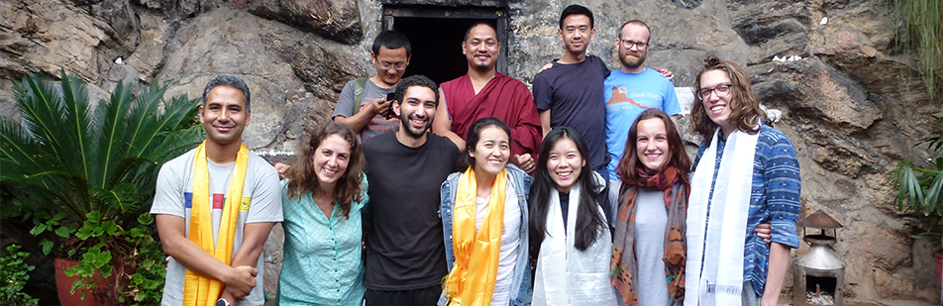
Discover PTRS
Places to Run & See and Call the World your Home
international experience

Slide 2
COVID-19
2022-23: Possibilities will depend on development of the virus and travel restrictions
2021-22: colour codes Dutch Ministry of Foreign Affairs leading

Slide 3
Possibilities for study abroad
(Thesis) Research abroad → appointment with International Office PTRS
Master programme (or 2nd Bachelor) abroad (VSB)
Short courses (summer or winter schools, courses at Dutch Scientific Institutes Abroad (Athens, Rome, Florence, St. Petersburg, Rabat, Istanbul). November 23, 12:30-13:30.
→ Interested? → Put your name on the list for an invitation for our Short Courses Abroad session
Edges of Europe → Check the PTRS course catalogue for modules in the second semester
Internship → appointment with International Office PTRS
Semester Exchange

Slide 4
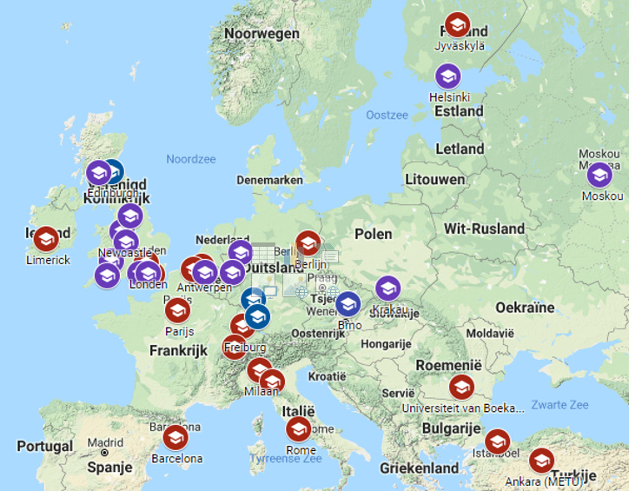
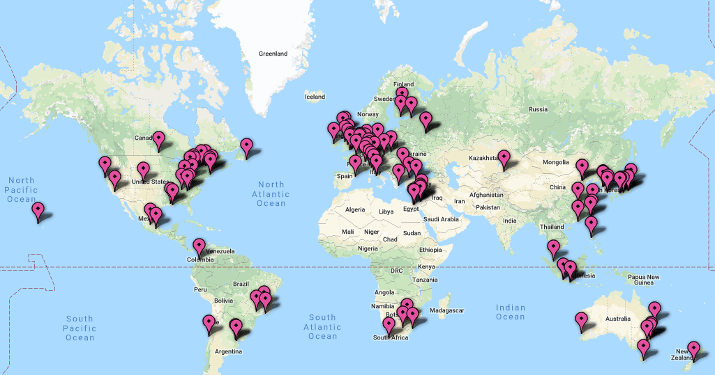
Destinations

Slide 5
ExQuizit Exchange!
An international quiz to find out more about our exchange destinations. During the session you can meet internationals studying at Radboud University with whom you can exchange more about their countries and about Nijmegen and the Netherlands too.
Thursday, October 14 – 16:00-17:00 – Find more information here
Other Sessions in the Radboud Go Abroad Week
Go Europe! Erasmus+: What's in it for you? Wednesday, October 13 – 12:30-13:30
Go global! Discover destinations outside Europe Thursday, October 14 – 12:30-13:30

Slide 6
How do I make the right choice?
  You decide where you want to go:
    In Europe or outside of Europe
    Campus university or not
    Small of big university
    Type of city
    Budget
    Course offer
    Language of instruction
    Prerequisites: GPA, language proficiency, minimum EC
    Semester start-end
  Ask teachers, fellow students, study advisor
  Durf te kiezen voor een Buitenlandverblijf (in Dutch) Vr. 15 oktober, 10.00 - 11.00 uur, Erasmusgebouw E 1.15
  Exchange Tinder quiz
  ExQuizit Exchange! Thursday, October 14 – 16:00-17:00 – Find more information here
  Meet the International Office PTRS

Slide 7
I want to go abroad – how do I start?!
Partner universities
  Radboud Tuition Fee
  Credits will be transferred to Radboud transcript
Scholarships
  For all Radboud students (amount depends on destination)
  Sublet room in Nijmegen safely through Radboud International Office (+ 350,- one off bonus)
  Possibility to temporarily stop your DUO student OV (+/- 90 euro per month)
  DUO loan

Slide 8
  When can I go Abroad?
60 EC, admitted to 2nd BA year
PM: prepare during PM, go when MA student
BA students
  Admitted to year 2, minimum of 60 EC before departure
  Mobility windows to avoid study delay:
    PPS - Philosophy - Theology – Religious studies: 1st semester B3 (PPS poss. 2nd semester B2)
    Islamic studies: 3rd period B2 (minor Arabic in Caïro or Rabat)
MA Students
  Research master: 1st semester 2nd year
  Other MA’s : no mobility window, absolutely possible

Slide 9
Financing your semester abroad
Costs
  RU – tuition fee
  Housing
  Living (necessary and fun)
  Travel
  Vaccinations
  Visa
Income
  Scholarship (€200 – €360 pm) www.ru.nl/io
  DUO
  OV (+/- €98 pm)
  Sublet room via Radboud IO (€350,- one-off bonus!)

Slide 10
Study abroad – procedure 2022-23
Going abroad in 2022-23
  Go Abroad Week (11-15 October 2021) - Information for semester abroad in 2022-23
  Walk in Office afternoon: Mon 11 Oct, 13.30 - 16.00 hrs, E 15.27
  Walk in Office hour: Tue 12, Wed 13, Thu 14 Oct, 12.30 - 13.30 hrs, E 15.27
  Q&A session with incoming and outgoing students: Fri 15 Oct, 12.30 -13.30 hrs, E 2.72
  Deadlines for application for study abroad semester in Osiris:
  Outside EU – 31 January 2022
  In EU – 28 February 2022

Slide 11
Information and questions
Radboud Go Abroad Week 11-15 October 2021
Information
www.ru.nl/ftr/studereninhetbuitenland
Facebook page International Office FFTR
Instagram Faculteit_ftr
Questions
International Office PTRS
Walk in office hours Erasmusbuilding, E 15.27
Monday, October 11, 13.30 - 16.00 hrs
Tue 12, Wed 13, Thu 14 Oct, 12.30 - 13.30 hrs

Slide 12
(Online) Individual Appointments after Radboud Go Abroad week
International Office PTRS
Monday October 18: 12:30-13:30
Tuesday, October 19: 11:00-13:30
Wednesday, October 20: 11:00-13:30
Monday October 25: 12:30-14:30
Tuesday, October 26 : 11:00-13:30

