Slide 1
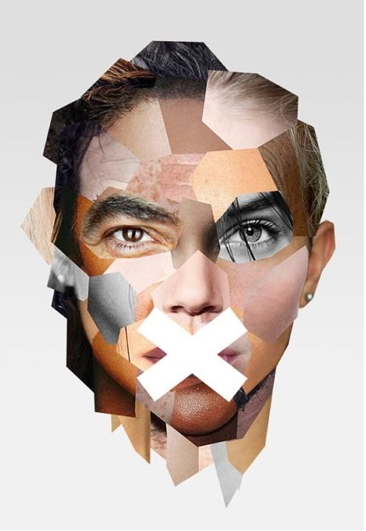
UNHEARD
Carry, E.P. INTROSPECTION (2021) https://www.pinterest.fr/pin/443252788310563279/
Pelle
Depla
Rogier van der Weide
Isabelle Klaver
Camille Collados

Slide 2
TABLE OF CONTENT
Editors’ Letter p.2
Quiz p.3
The numbers p.6
Unheard’s stories p.8
Abdul
Yoann
Jaap
Our readers’ opinion
The facts p.20
Crossword p.21
The Danger of Populism p.22
Cas Mudde’s interview
Homo and Femo Nationalism
Representation in Politics - ProDemos
Sudoku p.33
Initiatives p.36
Unsung + Unheard
Partij voor de Dieren
COC
Thank you note p.41
Meet our editors p.42

Slide 3
Before you is a (digital) copy of our magazine. We, Pelle Delpa, Camille Collados, Isabelle Klaver & Rogier van der Weide, have created this magazine for a Radboud University master course on political representation. We were tasked with defining and researching what we believe to be the biggest challenge for representation today. Together we quickly defined populism and populist rhetoric as the biggest challenge. The perspective of ‘the people’ as one homogenous group is something we believe to be dangerous and therefore we have tried to shed light on different perspectives and people contrasting this. We believe that society consists of many different people and lived experiences which each face different challenges when it comes to representation. The populist idea that there is one, united people which have uniform and clearly defined interests erases these relevant differences and renders groups invisible. Therefore we have tried to give a voice to as many different people and perspectives as we could given the time and resource constraints we faced. When you continue to read this magazine you will come across interviews with people with different backgrounds, columns from societal and political organizations and relevant statistics on representation in the Netherlands. We hope you will gain new insights and that this may lead to a more critical view of populist parties and politicians, but we also hope you enjoy the content as much as we have enjoyed creating it.
Camille Collados, Pelle Depla, Isabelle Klaver & Rogier van der Weide

Slide 4

QUIZ
UNHEARD
This magazine uses many term referring to political phenomena. This little quiz will help you to familiarise with these concepts in a fun way!
Substantive representation happens when…
a. the representative has a symbolic meaning for those being represented.
b. the representative advances the policy preferences that serve the interests of the represented.
c. the representative is elected directly by the people
Answer b
Populist rhetoric portrays…
a. immigrants as a hope for more heterogeneity in the people.
b. highly educated as the only people fit to govern.
c. the people as a homogenous group of pure individuals that are oppressed and logically not a part of the corrupt elites.
Answer c
Western exceptionalism…
a. refers to the idea that the west is unique and that its political system should be exported all over the world.
b. recognise that homophobia has been exported by western ideology and religions to other cultures during colonial time.
c. depicts the West as exceptionally tolerant towards LGBTQ+ people and women; it also depicts countries outside Europe, primarily Muslim countries, as oppressive to these groups.
Answer c

Slide 5

Descriptive representation happens when…
a. the representatives look like, have common interests with, or share certain experiences with the represented
b. the representatives understand the interest of the represented.
c. the representatives have autonomy to deliberate and act as they see fit, in their own conscience even if it means going against the explicit desires of the represented.
Answer a
Radical right wing populist parties argue that…
a. people of colour are part of the people and face intersectional inequalities in political representation.
b. the people have similar ethnographic characteristics and the elites are those that threaten this unity by allowing refugees in the community or giving away sovereignty to non-domestic powers like the European Union.
c. non-domestic power such as the European Union provide some safety for national government.
Answer b
Populism is a threat to democracy because…
a. there are many inconsistencies in populist discourses about what constitutes the people and its values and what threaten them.
b. the people should be understood as an irreducible plurality, consisting of free and equal citizens
c. it has never proven to be efficient.
All of the above

Slide 6
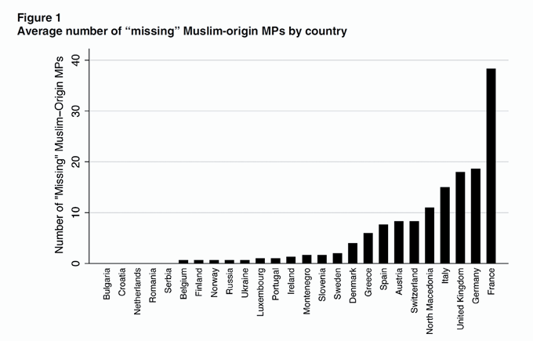
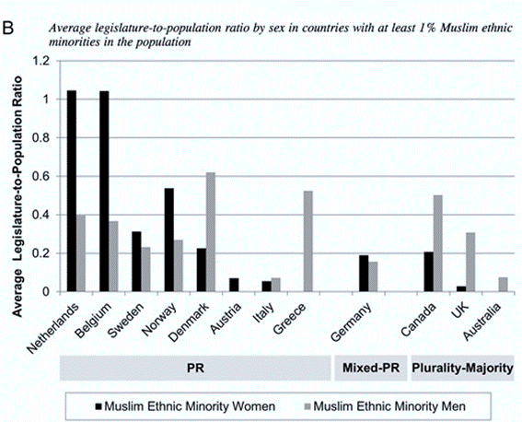
REPRESENTATION; WHAT DO THE NUMBERS SAY?
UNHEARD
We kick off this magazine with some graphics illustrating the current state of political representation hoping that it will help you to understand the importance of this topic.
This graph shows the number of politicians of Muslim-origin that are missing in parliament if they were to properly represent the percentage of Muslim people in the country. A high number in this graph thus indicates a large difference between Muslim people in society versus in politics. A low number indicates that the number of Muslim people is relatively equal to the number of Muslim people in parliament.
Fig.2
This graph shows the distribution of male and female politicians with a Muslim ethnic background in countries that have a Muslim population of at least 1%. The Netherlands and Belgium thus have a relatively high number of female Muslim representatives while Canada and the UK have a relatively high number of male Muslim representatives.

Slide 7
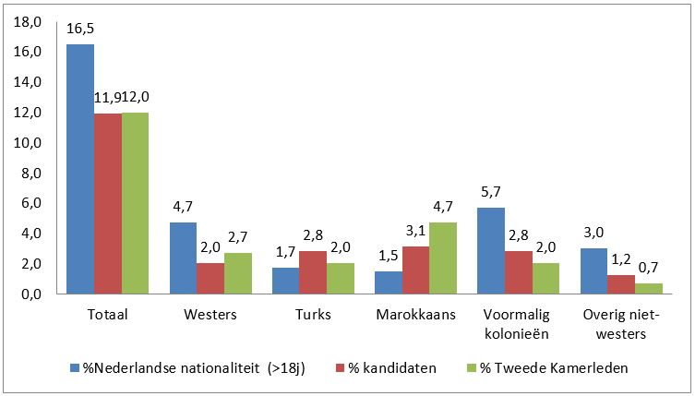
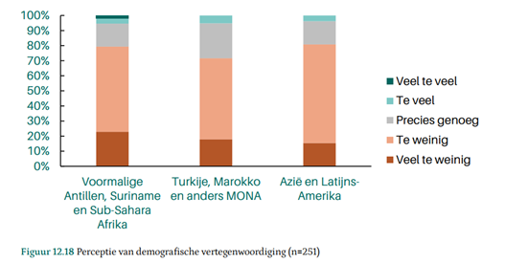
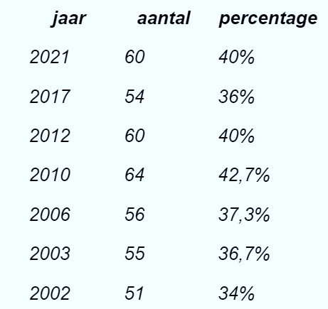
Fig.3
This graph shows the percentage of people with a certain ethnic background in the Netherlands (blue column) compared to the percentage of people with that background in parliament (green column).
Fig.4
This graph shows the feeling of being represented in certain ethnic groups ranging from ‘too much’ representation in blue to ‘too little’ in red.
Fig.5
This table demonstrates the number and percentage of female politicians in the Dutch second chamber.
Sources:
Hughes, M. M. (2016). Electoral systems and the legislative representation of Muslim ethnic minority women in the West, 2000–2010. Parliamentary Affairs, 69(3), 548-568 https://academic.oup.com/pa/article/69/3/548/2240765
https://www.dpes.nl
https://www.parlement.com

Slide 8
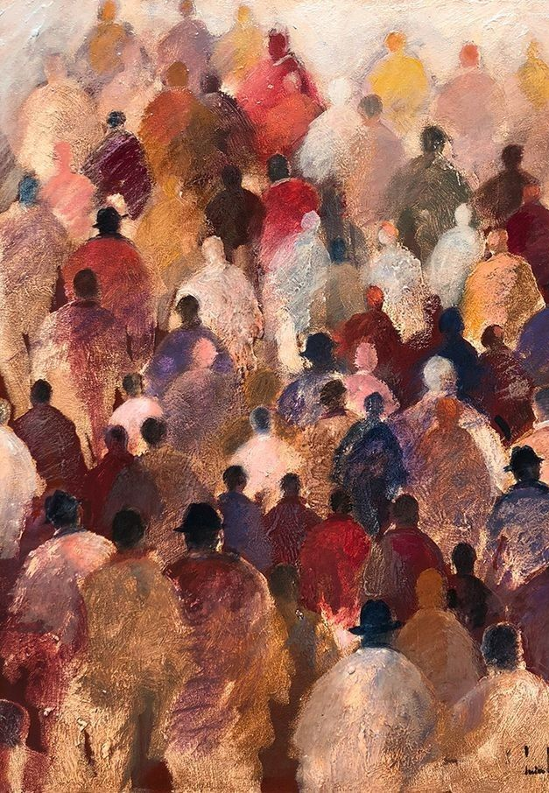
Unheard’s stories
The first step to giving a voice to those who feel unheard is to let them tell us their stories.
In the following section, you feel find the story of Abdul, a refugee from Dubai, the story of Yoann, a homeless young man and the story of Jaap, a queer transport worker.
We also included concerns from our readers that were raised in our survey.
Suire Verley, O. (date unkown) name unknown

Slide 9
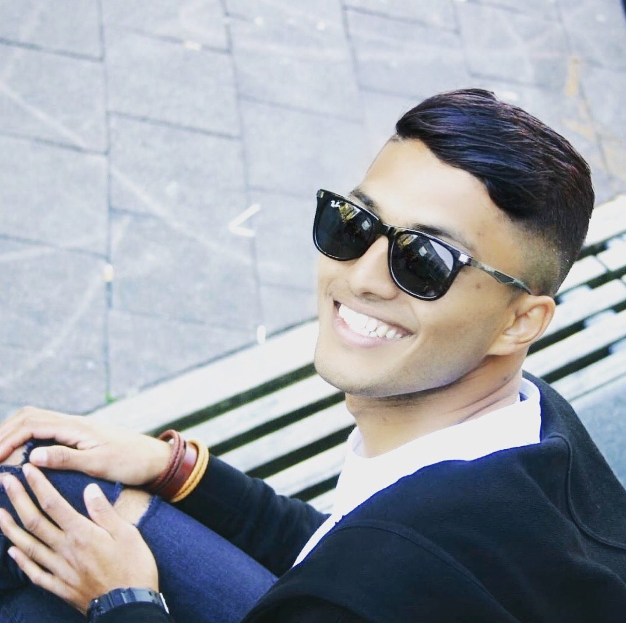
UNHEARD
Unheard’s stories
ABDUL
The representation of refugees
“I DO NOT TRUST POLITICIANS AND DO NOT WANT TO BE INCLUDED”
Thank you for joining this interview, could you shortly present yourself?
“Well, I’m Abdul. My parents are from Myanmar and I am from Dubai. I was living in Dubai all my life and now I am here. I study for my language course. It’s a Dutch course. I almost finished, afterwards I want to do an “opleiding”, a course to become a helper for older people.”
As we are going to talk about political representation, do you feel represented in politics?
“Uhm, no. I do not want to be included in any politics. It is not my thing, because some politicians just care about their own benefits at the cost of the people, they pretend they are helping the people but in the back they do not do anything. I do not trust them”
What is politics like in Dubai actually?
“Well in Dubai, politics is different. Every city has their own rulers and they have an understanding with each other.
But whenever they want to make money, they raise the electric bill, or money for the fuel, the rent or for everything. It is a bit about them wanting to get rich and wanting to get more money from the people. Okay let's put it like this, for example, they can not ask people to get them money directly so they do it more sneaky by raising the bills. They increase the price of everything. Also the visa, you have to pay for the visa, for insurance, they keep increasing it.”
How far does your knowledge go when it comes to Dutch Politics?
“Well I know Mark Rutte and I also know this guy Geert. Rutte, he really thinks of everyone but I think he is too nice to everyone.. What I heard is, he thinks a lot about the humans and the people that live in the Netherlands, he also thinks about refugees.. but with Geert.. I have a problem with him, he is a bit racist. He has problems with refugees or maybe people that are not from the Netherlands. He is making a stereotype.”

Slide 10
Do you think you would vote in the next elections?
“I can not vote, because I do not have the Dutch nationality yet. As a refugee, you have to stay for 5 years, you get an ID card after 5 years, we have to do exams and we have to do an inburgeringscursus, with the exam we learn the language and we get to level A2, then we get the diploma and then we can also work, after 5 years you can get the Dutch nationality.
Do you think it is fair that you can not vote? Because you live in this country, you work here, don’t you think it is important that you can vote?
“For now I do not think so, it is important I can understand Dutch rules and regulations first. Refugees do not know everything about the Netherlands.”
When you were living in Dubai. Did you feel represented there?
“I think, yes, there was one politician, Sheikh Zayed al Nahyan, he was the ruler of Abu Dhabi and he was thinking about everything. He also cared about people from other countries and the locals, he was accepting everyone as a human, he did not care about the country. He just said “okay they are our people”, but now he is dead and a lot has changed.”
Do you think it is fair that you can not vote? Because you live in this country, you work here, don’t you think it is important that you can vote?
“For now I do not think so, it is important I can understand Dutch rules and regulations first. Refugees do not know everything about the Netherlands.”
“FOR NOW, I DO NOT THINK IT IS IMPORTANT FOR ME TO VOTE. I NEED TO UNDERSTAND DUTCH RULES AND REGULATIONS FIRST”
When you were living in Dubai. Did you feel represented there?
“I think, yes, there was one politician, Sheikh Zayed al Nahyan, he was the ruler of Abu Dhabi and he was thinking about everything. He also cared about people from other countries and the locals, he was accepting everyone as a human, he did not care about the country. He just said “okay they are our people”, but now he is dead and a lot has changed.”
What was your experience about coming here as a refugee? What was the process like?
“The process was very long, first I came to Italy but we did not have any rights in Italy, so we came to the Netherlands to live. They said we have to go back to Italy, and we had to stay 6 months here in the AZC. Then we had to go out, they gave us tickets to go back to Italy. But we really did not want to go back to Italy, we experienced much discrimination there and it was not good. So, in the Netherlands a man, an acquaintance arranged a house for us to live temporarily with other refugees, but one day the police came and they took everyone to prison.”

Slide 11
UNHEARD
Including you, you were in prison?
“Yes, one day in Leeuwarden and then we went to Zeist, they kept us with the criminals for two weeks there and then the police took us to the airport, to Italy. We were in the AZC there for a year. They did not tell us how long the process would be, whether it would be a year, 5 years, 10 years, we had no clue. They also did not give us any pocket money or something. So it was hard, we also could not work anywhere because we did not have any documents. Somehow, we came back here to the Netherlands, we tried again. I was able to stay in the Netherlands for 18 months at that time and then the regulation of Dublin did not count anymore. I asked my lawyer, can I ask for asylum now? He said yes and he did all the paperwork for me.
And then after one year I got my interview, they asked me about my past and everything , it took a year. Then I got everything, the paper and the house.
Do you think that since for example the process was so long, there should be someone in the government that takes care better of refugees?
“Yes, they should think about it and care about refugees in particular. For now, it is really not good how they treat refugees. I also see it in Ter Apel. They are living in a really bad situation and the process is too long. It is not nice, they have problems in their home country and they want to have a good life here. So politicians should make better regulations for them, and they should speed up the process.”
Do you feel like you are being heard by politicians? Do you think they care about issues that are important to you?
“I do not really know, I don’t think so. I just see what I see and that is that they should care more about the refugees. For example, when you are in AZC you have your own contact person that takes care of for example paperwork, they are responsible for you. When there is a problem you go to them.. So what I mean is there are people in practice that are doing a lot for you, and it is good to have this kind of person. With politicians I find it hard to know what they do for refugees, I don’t see them, there is no contact. So it is hard to answer that question.”
Yes I understand, what do you think politicians can do to protect refugee rights more? What should they change? What can be better?
“They have to change the procedures, give them more rights. And they take so long for the interviews, it is too long. It should be easier and quicker for people to start to live. You’re wasting the time of refugees, maybe they might do a good job and do things that are good for the country. I also think the government should make the rules less strict. There are too much rules. Politicians should think about every human. They are working for humans so they should care about them, and not take benefits. Like I said, some politicians just look for their own benefits. They should care about some people and not just a certain group, not just the rich white people. In Dubai I see that only the rich people can vote, in the Netherlands it is better I believe but I still think politicians are selfish and care mostly about their own benefits and not about humans.

Slide 12
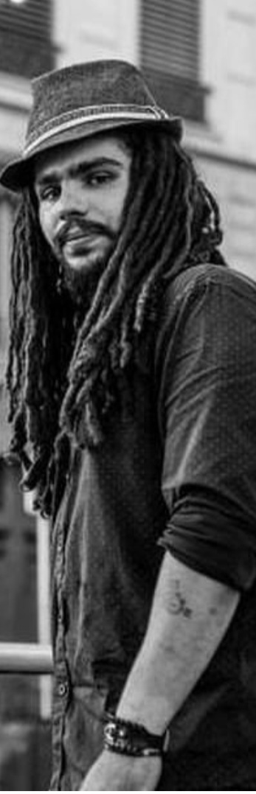
Unheard’s stories
Yoann Valento
The difficulty of representation for homeless people
I think that the representation of homeless people is very tricky because you will never have a homeless person in the parliament obviously and I cannot think about any politicians that used to be homeless. Also, it is not like you can easily vote, like me for example, I get my papers stolen every six months, it takes forever to remake them and you cannot vote without an ID. In addition to that, you need to register somewhere to be able to vote, you can register at a shelter but not everyone can go to a shelter, that’s something people don’t understand. I have five dogs, try to find a shelter that let me in. People tell me to abandon my dogs, it shows that they do not understand what it is to be homeless, they are all that I have. That is the thing with politicians, they think that they know what is best for you but they have no idea how we live. They never even talk to us; we are not part of “the people”.

Slide 13
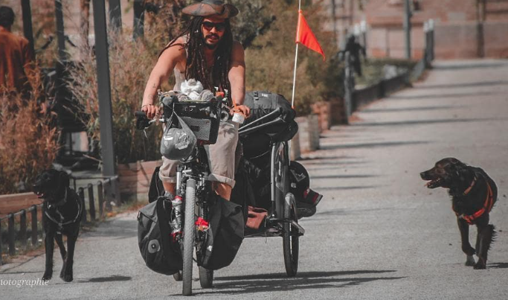
UNHEARD
I have been in the street since I am fifteen because the government did not help me when my mom was in a psychiatric hospital and my dad was abusive. Since I came from a difficult background already it was hard to focus in school, I was not a good student; so teacher did not help me either. Then I was not being the smartest and living in the street is hard so sometimes I got violent to protect my stuff or my dogs. When this happens and the police intervene, they are not here to understand the problem they are just here to beat you up.
Then it is a vicious circle, if something happen you don’t go to the police, because you know they will not help you, and once again there is the issue for getting your papers stolen, try to go to the police without papers. All of these, police, social workers, they are what I see of politics, and it is not pretty to see. Look at my friend, both her parents died and her social assistant was stealing money from her saving account. She is not 18 and her social assistant was her legal representative. How do you want to trust politicians when you see this happening and nothing is done about it? So, you build your own world, your own system to not get crazy and it cuts you more and more from the actual political system. But I see you and your project, it gives me some hope for the future politicians, if they listen to us that would be a good start to represent us.

Slide 14
UNHEARD
Unheard’s stories
Jaap
LGBTQ+ representation: I don't feel underrepresented but I don't feel represented on a personal level either
Could you shortly present yourself?
I am Jaap, 33 years old, I work in public transport. As management these days. In addition, I am committed to all kinds of queer initiatives, like the education team of the COC. And I'm working with HizzFit to set up more (sports ed.) training courses for the queer community. My part in this will mainly be a piece of martial arts. And I was recently approached again by a young group of squatters in Nijmegen who want to crack things.
Do you feel represented in politics?
More and more, I think. But I think that's more because I'm becoming more moderate myself than politics becoming more in line with how I used to feel. I think that's it. I notice that I put things into perspective more and more often, whether that's because I think ‘it's not going to be solved anyway' or because I'm actually becoming more moderate. I do not know. But if you had asked me, as a twenty-year-old myself, then no, certainly not.
So actually you have changed more than politics has changed for you?
I think so.
Yes, look I'm a staunch GroenLinks voter and I come from an SP nest. My father and mother are renegades these days. They are no longer SP. The only thing that really scares me now is that you get large polarization. So really very right versus old-fashioned left. And I don't think GroenLinks has the right answer to that either. But I also used to feel unrepresented by GroenLinks. Look, I'm 33 now and I finished Havo. I never finished anything further. If you now look at the traditional GroenLinks, they are all relatively highly educated, semi-elitist behaviour, you know. Then I think; do I feel connected to Jesse Klaver? No.
Are you involved in politics? Did you vote in the previous elections?
I have always voted in every election since I was 18, whether it is for the Water Authorities or a municipality. First with a kind of cynical look. If I just vote 'hey if it works then it works', and if it doesn't work then I have lost nothing. Then at least I tried. And now I honestly think that voting in some form works. Whether the entire electoral system is correct is a very long discussion. But at least the voting itself I think works.

Slide 15
And how did you gain that confidence? Why has that cynicism disappeared?
Partly because I got to know people, within GroenLinks Nijmegen, that I really liked. The current party leader in Nijmegen, he is just a great person. And only later did I find out that he was GroenLinks Nijmegen party chairman.
Do you have trust in the current cabinet and current policy?
That is difficult because on the one hand certainly not. That is due to the constant focus on the citizen and the total unrestraint of large companies. That's really something I miss. The VVD does not dare to comment on that either. But have they worked for certain other developments? Yes. But it is a bit difficult to say whether these developments would have taken place under a different cabinet anyway. For example, extra housing that is now being built. Many construction projects are underway. But almost all of this is a municipality initiative.
So is the government dealing well with the current problems?
If we look purely at the cabinet, I don't think so, even if you look at the last four social unrest crises. Whether it was the farmers or Black Pete. Then you never actually see that Rutte is at the forefront. He always comes after a week or two when it has all escalated. Then he shows up once. So no, certainly not at cabinet level. Yes, if you look at GroenLinks Nijmegen here.
How do you think the people around you relate to politics?
When I look at my family it's like old times. They vote and they don't always agree with what happens but that's the way it goes. When I look at friends and immediate surroundings, there is a great deal of distrust. They are all pretty much on the same political spectrum as me. Only when I look at work, for example. Yes, bus drivers in Nijmegen are generally 50+, white and male. And there is a lot of skepticism there, and perhaps also very right-wing. They are very suspicious.
“THE CABINET IS NOT DEALING WELL WITH CURRENT PROBLEMS”
And does that lead to an aversion to politics, perhaps leading to them not voting?
Yes, I think a part has always not voted, as a lack of interest. But I think a large part of them may no longer vote. They hang the flag upside down and think they cast their vote.
What do you think of that yourself?
I'm not going to pass judgment on the fact that they don't vote. As in, that's up to them and they can also choose that all by themselves, but the fact that it happens can be blamed on politicians. Of course, as a politician you also have to give a certain bonding and confidence to the public that they have the confidence that their vote is useful. I think that politics has also contributed in a certain way to the polarization that is now taking place.

Slide 16
UNHEARD
And what could politicians do to win that back?
That's a very interesting question. I think that for many voters, as long as none of their preferred political parties is in the cabinet, nothing will ever change. Yes, the stupid thing is that politics is still politics. So if they vote and they don't come into power, then you don't come into power.
You say 'I am a loyal GroenLinks voter', is there a person by whom you feel most represented or is that really more the broad party?
No, that's really the broad party. When there are parliamentary elections or the municipal elections here in Nijmegen, Quirijn (Lokker; party leader GL Nijmegen ed.). That's someone I know, I trust him. So that is indeed a person. But if I look nationally then I'm going to go through that voting list and then one year I might feel more drawn to the first woman or a female party member or someone with a migration background or perhaps the first queer person. I kind of look at that. I never actually vote for number 1.
Do you think it would help if politics itself became more diverse?
I think so. Politics should be a correct reflection of society. In essence it is not anyway, because there is simply a huge educational difference. If you look at my GroenLinks party, you will also see a difference in education. I think, don't think anyone on that list is below HBO level, education wise.
I think we're missing a bit with that as well. Because if you as a party, you will also miss voters. If we look at the Netherlands – so we have a certain amount of people with a migration background, but you now look at the cabinet, then of course that is not a reflection of society at all. I think there is definitely room for improvement there.
“POLITICS SHOULD BE A CORRECT RELFECTION OF SOCIETY, BUT IT IS NOT BECAUSE THERE IS A HUGE EDUCATIONAL DIFFERENCE”
Do you also feel that your personal background plays a role in how you view politics?
I do think my background does indeed, certainly – if you look at the queer part anyway. I am well aware that the queer representation in the Second Chaimber, in the cabinet, is mainly LGB, and then the rest is missing again. There is now one transgender MP. I don't think politics represents all the letters right now.
So there are both at the level of politicians and at the level of policy, groups that are not represented? Either because they are not present or because no policy is made that benefits them.
100%. If we now look that mainly in politics – as far as our workshops are concerned, we also have a bit of sexual preference. So gay or lesbian, but also a bit of gender identity. And for that piece of gender identity the government is not ready yet.

Slide 17

And do you see that changing soon?
No. I am very pessimistic about this, we could have improved policy in other areas a long time ago. Think about the environment. That is not something from the past two years, or the past ten, twenty years. The moment we got the hole in the ozone layer we already knew that was our influence. Have we acted accordingly in the Netherlands? I do not think so. Well if you extend that to other areas, including LGBT or housing. Yes. It's just recently not happening. I think politics is too slow.
Do you think that there are also groups within politics that deliberately slow down?
I think so. And that may sound stupid, but it is their right. Because if you don't agree with it, you don't necessarily have to go along with it. Only then, I don't agree with those people either. Look, everyone has an opinion and that opinion tries to work through politics. And if you think the whole climate change thing is bullshit, then I understand that you don't go along with it. Do I agree? No.
So if you had to build some kind of ideal politician, what would it look like?
All in one. Definitely. Migration background, not white, preferably queer somewhere. Yes that would be great of course. And I also think that might be good for the country as well. As in, if someone comes to power with that and hopefully ends his four years in a nice way that you automatically gain more trust in the underrepresented groups, so to speak
The party mentioned in this interview; Groenlinks was founded in 1990 as a merger of four small left-wing parties. The red “groen” (green) emphasises on the link between the left and green parties. Hence, the party emphasises on ecological and social measures. It also advocates for no discrimination, racism or sexism.
The party has been criticised for emerging from a communist background.

Slide 18
UNHEARD
What else would you like to see?
I would find it very interesting if we were to drastically review things. What if, instead of continuing in the same way as we often do in politics. Let's take a look at letting go of old things and see how our state system works. I think we should all take a look at 'we all think A but we do B' and at the moment someone is C. For example, because someone has a migration background. Then they may not be able to participate with A either. We often say things, but we don't act on them. “yes I'm really not a racist” but you do use the n-word. Go take a look at that. “Yes, but that's okay. I'm not a racist but Zwarte Piet is black”. I find that kind of thing difficult. Those people need to look in the mirror a little more and be a little more honest. And if that can also be transferred to politics. That would be very nice. Because if you look at, for example, climate measures that have been taken and which do not apply to large companies. It is all very much focused on the citizen. That might be a bit of a VVD thing, so to speak. Hey 'the companies have to grow'. But companies should be looked at more often.
Who do you see as underrepresented?
I think that right now there is a real smear going on by the people against all refugees. I also found that poignantly visible, especially for refugees of color, when Ukraine got into trouble. Which is not to say that we shouldn't have helped them, but it became very clear that the treatment was just different. Let's say double standards were used. That's what I find most annoying at the moment. Because I also see it at work. There is a lot of racism in my work environment there. I also think that for LGBTQ+, that is mainly transgender and then also intersex. You don't really hear about that in politics. If I think about it now. But I think we as LGB are pretty well set at the moment.
You mention a lot of groups, but you are not part of them yourself. Do you think you are sufficiently represented?
I think I'm neutral on that. I don't feel underrepresented but I don't feel represented on a personal level either. But I don't mind.
You don't mind?
No. That is perhaps more of a personal trait. That you are more likely to have a problem with something happening to others than to yourself. Look, I can function just fine at the moment. I have my boyfriend, I don't have to worry about anything or be afraid in the street. I'm almost six feet tall so I'm not too worried about that. I am not hindered in my daily life.

Slide 19
OUR READERS’ OPINION
We asked our readers about their concerns on political representation and what topics they would like to be discussed more in the parliament. Here are some of their answers to help you give an overview of what people see as urgent.
“Something really has to be done for trans right, like forbidding conversion therapy to start with and appropriate trans healthcare… and the punishment for people that bully LGBTQIA+ should be much harsher.”
“To me politicians should really discuss more about true equality in every way of the word (economic, race, gender, sexuality, ability). Adequate and affordable healthcare, housing, education - basically aspects that affect marginalized people with lower incomes”
“Anything that isn't about capitalistic goals but rather going for more rights for women, more rights for minorities, equal pay, equal medical care and so on should definitely be discussed more in the parliament. There is a lack of representation in Dutch politics (especially in educational level, they don't know what is going on in lower classes)”
“The struggle of immigrants to find housing, serious jobs and to be confronted with casual racism on a daily basis should be addressed in the parliament.”

Slide 20
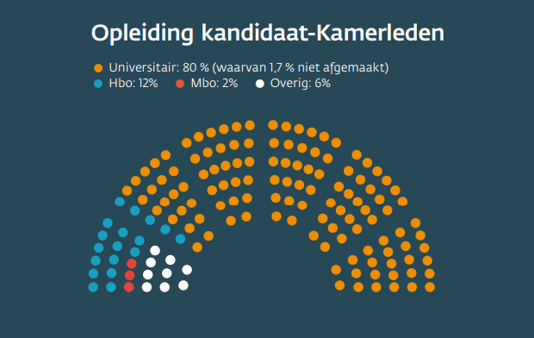
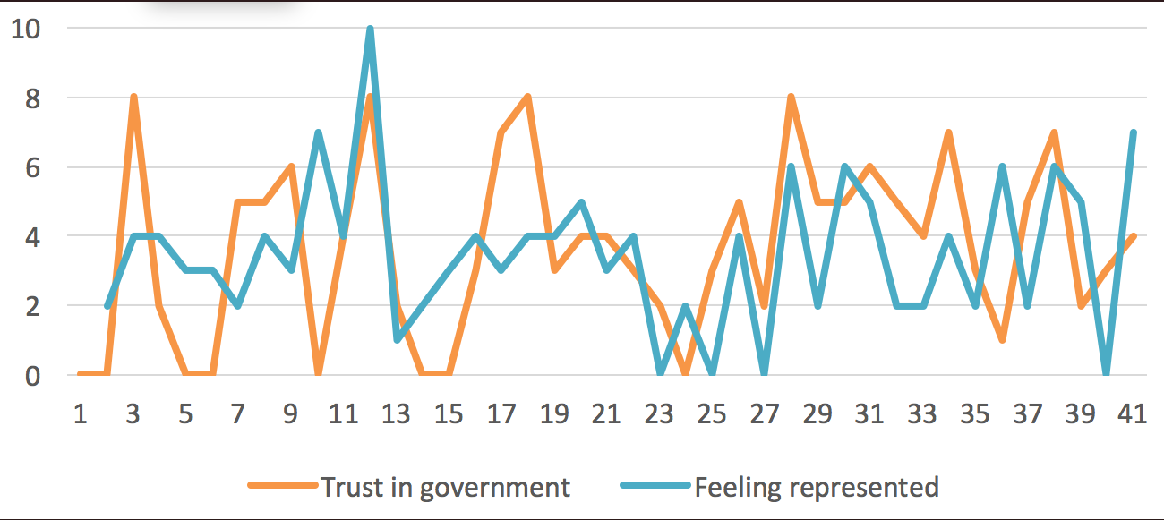
WHAT ARE THE FACTS?
UNHEARD
Fig.6
Just as our readers observed; this image shows the education level of the candidates for a seat in the Dutch second chamber in 2021. 80% have a university degree, 12% have a higher vocational education and 2% have an (intermediate) vocational education.
A study from 2013 found that in the Netherlands the first openly Gay MP was elected in 1981. In the period from 1976 until 2011 the Netherlands had 11 openly gay MP’s. Additionally, in 2021 the first and so far only, openly transgender woman was elected into the second chamber.
Fig.7
This graph from our survey shows that there is a clear correlation between feeling politically represented and trusting the government. The graph shows the distribution of how represented the respondents of the survey feel and how much they trust the government. The graph shows that the respondents are showing diverse answers on whether they feel represented or not going from scores down to zero all the way up to 10. Interestingly, none of our respondents gave a score of 10 on trust in government, while multiple respondents gave a score of zero.
Reynolds, A. (2013). Representation and Rights: The Impact of LGBT Legislators in Comparative Perspective. American Political Science Review,. https://doi.org/10.1017/S0003055413000051
https://www.socialevraagstukken.nl

Slide 21
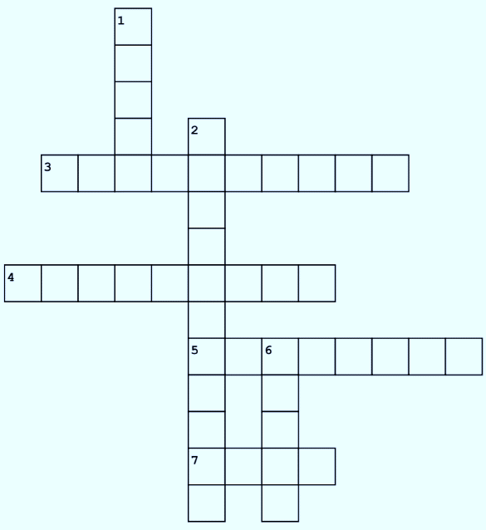
UNHEARD
CROSS WORDS
Across
3. Choosing one option over another
4. Opposite of dictatorship
5. Anti-establishment type of politics
7. .... in elections
Down
1. Opposite of the people according to populists
2. Type of representation where characteristics are
important
6. Group of representatives

Slide 22
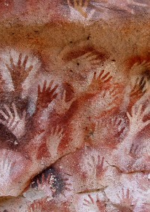
The dangers of Populism
Certain political parties claim to represent the voice of “People” against the “corrupt Elite”. These parties are considered to be populist, while their discourse can seem very appealing, such parties are actually a threat to democracy.
In this section, we interviewed Cas Mudde, a political scientist specialised in Populism to understand the struggles that democracy face.
We also dive into the issue of using feminist discourses against immigration, a strategy often used by Populist parties.
Additionally, Frank Wanders, from ProDemos provided us with a column on the topic of representation and the importance of democracy.
Strenske, B. (2010) Cueva de las manos

Slide 23
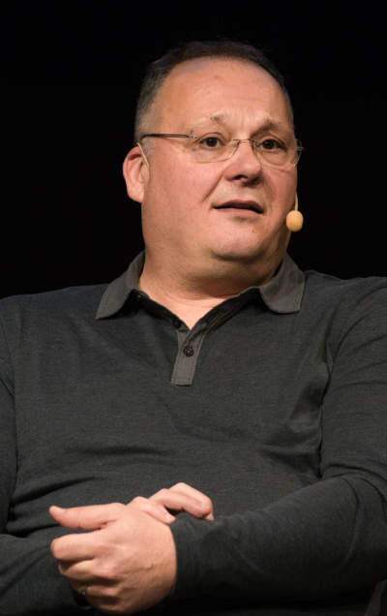
Interviews
“IN POPULISM, MINORITIES ARE BY DEFINITION NOT LEGITIMATE BECAUSE ALL YOU HAVE IS A GOOD PEOPLE AND A CORRUPTED ELITE”
CAS MUDDE
Leiden University (2022); Populism, Punditry and Political Science: A Conversation with Cas Mudde
What is a populist party?
I define it as a homogeneous approach to the people which is good, which is pure and which is engaged in a fundamental struggle with a homogeneous elite that is corrupted. And in most cases, this is combined with a xenophobic form of nationalism, but it doesn't have to be. In the Netherlands, almost all populist parties are also what is then called nativist. Examples are the PVV, Forum for Democracy, and JA21 to name but a few.
Yes, and very often it is simply used in a negative way. Isn't it also just a frame to put other groups of people away?
Yes, anything that can be considered negative can be used like that. The parties I just mentioned are populist. The fact that that is seen as a curse by them is of course also part of the political struggle. The right uses socialist as a swear word and we still use socialism. So the point is, swear words, all political terms can be swear words. You're even being "called names" these days because you want to be good. So for that matter, populism isn't even such a swear word really, because populism is also an euphemism.
Cas Mudde (born 3 June 1967) is a Dutch political scientist specializing in extremism, populism, and democracy in Europe and the United States. After his tweet about the problem of marginalized voices not having a mainstream media platform to amplify their voice, Unheard invited Cas Mudde for a short interview

Slide 24
UNHEARD
You talk about populism the way the media talks about populism, but you're actually talking specifically about a group of parties for which populism is a secondary feature. I mean for the PVV, JA21, Forum for Democracy, et cetera, which are primarily based on nativism and you use even stronger words, racism. They would much rather be called populist than racist. And we often use the term populism because we know that whoever we call populist gets, let's say, less angry about that than if you call them the radical right, let alone call them racist.
There are also scholars, take Nadia Urbinati, who says that contemporary populism, is something negative because it has an exclusive nature of a popular approach and is therefore in conflict with democracy in itself. Do you share that approach?
Well, I share the approach that populism goes against liberal democracy. Nadia Urbinati and Jan-Werner Müller do not distinguish between liberal democracy and democracy in the sense that they believe that democracy can only function if it takes the form of liberal democracy. But I agree. The fact that you state that populism is incompatible with liberal democracy is not a value judgment, that is a fact. The fact that you say that it is negative is a value judgment. And you can distinguish those things. So objectively, populism goes against liberal democracy.
When we look at what people think is important, we also attach great value to our democracy. At the same time, we see a very large populist wave, especially the radical right populist wave. How can it be that so many people still opt for a populist party, even though we have a broad consensus in the Netherlands about the importance of democracy?
Yes, I think there are a few things going on here. First, the public debate on democracy is very much about majority decision making and that is a very narrow interpretation of democracy. In a liberal democracy, it is about majority decision-making and the protection of minorities, and that aspect is much less emphasized. And so for many populists, they see democracy first and foremost as policy or politics based on what the majority wants. And if you also have a very homogeneous view of the people, then you think that you are a democratic movement. Because you are the voice of the majority and minorities are less important anyway. That's not our model of democracy, but in populism, minorities are by definition not legitimate because all you have is a good people and a corrupted elite.
“POPULISM GOES AGAINST LIBERAL DEMOCRACY, THAT IS A FACT”

Slide 25
So it has to do with a narrow view of what democracy is on the one hand and a redefinition of who the people are on the other. In their view, they represent the whole people and are therefore democratic.
Populists can very easily sell their agenda as democratic and that is also an important point because it says something about the hegemony of democracy. The vast majority of people in the Western world support democracy and think it is the best system. And so if you want to be popular, even if you're against the existing system, you'll still have to sell it as if you want to save democracy or protect real democracy. And that's no small detail. I mean in the 1930s, Hitler didn't pretend to want to protect democracy, it was fundamentally against the whole idea of ​​the majority deciding.
“POPULIST THINK THEY ARE DEMOCRATIC BECAUSE THEY ARE THE VOICE OF THE MAJORITY”
The mainstream parties or the traditional parties, what else can they do anything else or will we actually end up with a permanent battle between the broad midfield as we call it in the Netherlands?
Depends a bit on where you are. If you are in Poland you have to do everything on the street because the far right parties, have the majority in parliament.
When you're in the Netherlands, you have a very splintering right-wing populist party landscape, which in itself is relatively marginal in terms of power. I mean, they're not in government, none of them, they are not needed by the government. And that is the situation in the vast majority of countries. In the vast majority of countries, the traditional parties that call themselves liberal democratic are in full power. So they can do what they want. The Netherlands is an extreme example of this. Because since the rise of Pim Fortuyn, the right-wing radical elector has been elevated to the representative of the people.
And so what you see with people like Mark Rutte and the VVD, but also the CDA and other parties, they always talk about the concerned citizen or the angry citizen. But this ‘citizen’ is always a very specific, generally white, right-wing guy. But that's a choice, isn't it, they did that because 17 percent of the electorate had voted for a man to be killed and that was what the electorate could pick up. I don't like the defeatism of ‘we have to do this because that's exactly what the right parties use as an excuse why they use xenophobic rhetoric, why they close the borders, why they attack other things, why they attack the left, all that sort of thing”. That's all in the name of ‘yes we have to do this because this is what the people want or else the far right will come to power’.

Slide 26
UNHEARD
Because populists, of course, claim that part of the people, that 17 percent, have not been heard. But you are actually saying that these have been heard by a very large other section of the traditional parties today?
Yes, by the vast majority of political parties, but also by the media. It is important to note that in 2001 they were not heard, or much less. I mean, I grew up in the Netherlands in the 80s and 90s, when there was a very strong taboo on the theme of immigration, on the theme of European integration. And if you were critical of that, you clearly fell outside what was accepted. I mean, it wasn't a silent majority, it was a minority that was very critical of things. And we went from totally ignoring and even slandering themto now having everything revolves around this minority [populists].
At the same time I think we can say that there are very large groups that may not be heard because of this. I immediately think of migrants. Do you think they could actually benefit from their own kind of populist movement that can redefine the people?
Well, I don't believe in populism because it's a monist movement that goes directly against the core value of liberal democracy, which is pluralism. Migrants definitely benefit, as do other excluded groups, from a more inclusive definition of the people. And most Western European countries are still very far from but we do have a center-left party here that openly advocates a fairly inclusive policy that does not talk about tolerance, tolerating minorities which is always a hierarchical relationship. Those in power tolerate the other. Inclusiveness is a horizontal relationship.
“THE ’ANGRY’ CITIZEN RUTTE TALKS ABOUT, IS GENERALLY A WHITE, RIGHT WING GUY”
Do you think that democracy still functions properly in the Netherlands? Also when we look at the representation of certain groups.
Yes, everything is relative. I mean, now, I live in the southern United States. For me, the Netherlands is still a welfare state despite 20 years of right-wing dominance. The Netherlands can do much better, absolutely. On the other hand, the Netherlands is much better than the vast majority of countries in the world, even democracies. But the Netherlands has institutional racism, we have a prime minister who was guilty of this and until very recently denied the existence of institutional racism. The Netherlands is still primarily based on the ideas of tolerance, as I have said, rather than inclusion. But on the other hand, I mean when it comes to things like gay rights, in particular, the Netherlands is much further along than most countries. Trans is a bit of a different situation then. In terms of Islamophobia, for example, on a mass level, the Netherlands is no worse than other European countries. But if you look at the elite level, if you look at Islamophobia in politics or in the media, it's much worse. And that again has to do with how the people are defined. The Dutch are not nationalistic and always attack others about being nationalistic, but the Dutch don't say we are better, but everyone else is less good.

Slide 27
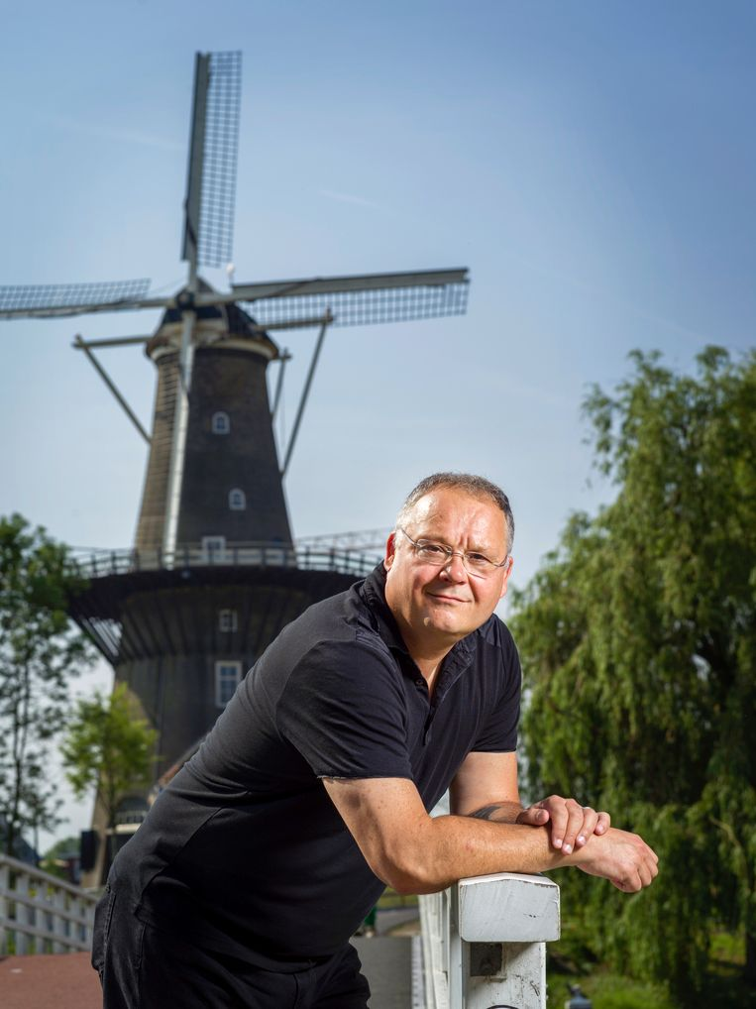
And I think the fundamental discussion about inclusivity is clearly still a long way off when you look at how BIJ1 is treated, for example. That is the only party that stands for a truly inclusive interpretation of Dutch society. They don't just say we tolerate you, but they say, for example, Islam is part of Dutch society, which it is natural and has been for a very long time. You don't hear that in other parties. Nevertheless, the discrimination of many minorities compared to other countries is not so bad. The welfare status even with institutional racism in the Netherlands, is significantly better than in other countries. So, a lot has to change, but you're already starting at a really high point.
To pick up on that, you already mentioned gay rights and inclusivity. Radical right populist parties often use the gay community or the LGBTI community to drive people away from other ethnic backgrounds. In the sense of we want to "protect" our gays against Islam. Why do those kinds of parties do that?
In Northern Europe, the right, and not just the far right thinks that gender equality has been achieved. This is objectively not true, but people are convinced of it. Same with the total integration of gays and lesbians. And it's important that this isn't about LGBTQI, it's about L and G. The rest is still very problematic, especially trans. But people think, especially in the Netherlands, that gays are fully accepted and integrated. We have told ourselves that because we have come very far in the 90s. And now in their eyes, it is being attacked exclusively by Islamists. There are two problems here. Yes, of course, there is homophobia within the Muslim community and it is also greater on average than the non-Muslim community.
Rosman, C. (2021) in Het Parool; Politicoloog Cas Mudde: ‘Als iets radicaal-rechts is, moeten we dat blijven benoemen”
But of course, there is also homophobia in part of the Christian community and that is never seen. There is also still plenty of sexism in the Dutch non-Muslim population. Let's face it, the Netherlands has still never had a female prime minister.
I mean, especially in the Netherlands, you have the SGP, to name just one example, but you also have the ChristenUnie that has been protecting those Christian schools that openly dismiss or do not hire gay teachers. But that is not seen. For someone like Wilders, gender equality and gay rights are part of the Dutch nation. For them, that is part of nationalism. Those are Dutch values, those are not liberal values, those are Dutch values. And they are then defended against a foreign or non-indigenous threat.

Slide 28
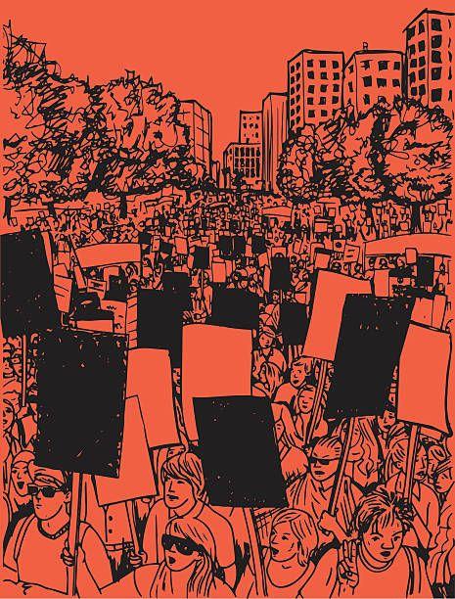
UNHEARD
Jayesh (date unknown) A protest
HOMO- AND FEMO-NATIONALISM
THE HYPOCRISY OF POPULIST PARTIES
Both rainbow washing and pink washing are when a business or state supports women and the LGBTQ community to boost its own image without actually doing anything for them.
The dangers of rainbow and pink washing have been brought to light, as it is undermining the true intent of Pride month and of the Feminist movement (raising LGBTQI+ and sexist concerns and fighting for their rights). It also misleads well-intentioned individuals into believing they are supporting women's rights and the LGBTQI+ community when, in reality, they're padding companies' pockets. However, a comparable but less well-known mechanism occurs in politics.
Homo- and Femo-nationalism refers to the idea that western values are unique and that gender and sexual equality are its main components. In the name of gender and sexual equality, this concept is used to legitimize the rejection of certain minority groups and cultures. Populist parties commonly use feminist rhetoric to claim that Muslims, and by extension migrants endanger the safety of western women and queer communities. Feminist movements' aim of liberating women and queer people from heterosexual patriarchal dominance is crossed with the racist labelling of all non-white males as sexual predators and intolerant of LGBTQI+ minorities. Populist parties are mobilizing feminist and queer communities to support racist and, in particular, Islamophobic rhetoric and policies.

Slide 29
But are they really defenders of LGBTQI+ and women’s rights?
In recent years, radical right-wing populist parties such as PVV in the Netherlands or Rassemblement National in France have gained popularity among citizens in Europe as they have entered a process of de-demonization through moderate speeches aimed at displaying a facade of respectability. Hence, such parties claim to defend women’s rights and LGBTQI+ rights by opposing immigration. They also use the rhetoric of homo-nostalgia, implying that queer people were safe in Europe before immigrants disturbed their security. Therefore, they appeal to queer voters who feel unsafe in their country and hope for protection. In the Netherlands, homosexuality has been promoted as part of ‘our Dutch tolerance’ and the Netherlands as a country is seen as a gay-friendly society.
Why is that a problem? And a safety issue?
Populist parties assume that immigrants and especially Muslims are incompatible with democratic values such as gender and sexual equality without protecting or promoting such rights in other context than the demonisation of Islam.
Let’s take a look at the PVV and VVD in the Netherlands, on the one hand, in their discourses they clearly depict immigration and Islam as a threat to Dutch values and people as they claim; “The Netherlands will not be the Netherlands anymore. This asylum invasion brings unprecedented suffering along for our people, who are harassed, robbed, raped and even murdered by the many asylum thugs”. In order to depict Islam and Immigration as a security issue for Dutch citizens, the VVD and the PVV use the vocabulary of war by employing words such as threat, danger, attack, enemy, fear, fight, and defend. Using the same rhetoric, they portray themselves as the defender of the Dutch People, believing that only their political program could protect them. In 2017, the PVV stated that they represented the interest of Dutch citizens by saying “Millions of Dutch citizens have had enough of the Islamisation of our nation. Enough of the mass immigration and asylum, terror, violence and unsafety. […] Zero asylum seekers added and no more immigrants from Islamic nations: close the borders”. On the other hand, the promotion of gay rights and sexuality within the program of the PVV and within the discourse of ‘Islamification’ still relates to a heteronormative nationalism, the way in which homosexuality is promoted and being used as a tool does not promote any gay rights on a practical level.

Slide 30
UNHEARD
By using the frame of homo- and femo-nationalism against immigration Populist parties offer many contradictions in their discourses. The PVV and VVD use the rhetoric of homo-nostalgia considering that the Netherlands was safe for LGBTQ+ people before the beginning of immigration while they themselves pose a threat to LGBTQ+ minorities. Yet, it is important to remember that the VVD voted against marriage equality and only shifted their standpoint to compete with the increasing influence of PVV using gay rights as a cultural phenomenon to be protected against immigrants. Furthermore, Gay is narrowly defined in the 2010 PVV party program. Besides ‘gay,’ no other non-heterosexuals’ identities are mentioned (i.e. bisexual, trans, lesbian). Furthermore, while white heterosexual men’s violence against women is neglected. Ethnic minority women, described as ‘immigrants’, have to be protected from genital mutilation, forced marriages and sexual and honour-related violence. In both cases, women are victimized and have to be protected from ethnic men.
This show that populist parties clearly depict Islam as repressive for women without considering that women could choose by themselves to wear the hijab without being forced or indoctrinated. The PVV clearly supports women’s emancipation but they mark the boundaries of being a ‘Dutch emancipated woman’ and by that produce the other ‘foreign unemancipated woman’ at the same time. In the case of the PVV, the latter are Muslim women and women from ethnic minorities.

Slide 31
A second contradiction appears in VVD and PVV’s discourses. While, on the one hand, Islam is depicted as regressive, and incompatible with Republican and democratic values. On the other hand, many representatives of Radical right-wing populist parties repeatedly explained that Dutch values were based on Judaism and Christianism as Geert Wilders of the right-wing Party for Freedom (PVV), argued, “Dutch values are based on Christianity, on Judaism, on humanism. Islam and freedom are not compatible…You see it in almost every country where it dominates. There is a total lack of freedom, civil society, rule of law, and middle class; journalists, gays, and apostates—they are all in trouble in those places. And we import it.” Therefore, populist parties use a double standard regarding the relationship between religion and politics.
So, why does it matter?
Populist parties have gained influence in European countries and within the European Parliament in recent years due to their de-demonisation strategy and the use of homo-nationalism discourses. Yet, if LGBTQ+ minorities believe that their interests are being represented by radical right-wing populist parties. While the PVV and VVD dismiss discrimination against LGBTQ people, the parties do not propose policies to improve their emancipation or safety in either their party program or in the media. Their policy proposal is thus only used to promote a restriction on the overall admission of immigrants to the Netherlands

Slide 32
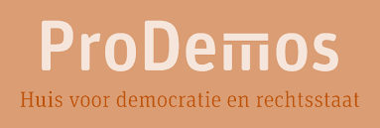
UNHEARD
REPRESENTATION IN POLITICS: LEARNED YOUNG IS DONE OLD
Written by: Frank Wanders, wetenschappelijk adviseur ProDemos – Huis voor democratie en rechtsstaat.
The House of Representatives cannot function without input from society. For a representative democracy, the voice of the people must be heard. Currently, this is not happening proportionally among the population. For years we have seen that practically educated people are structurally under-represented in elections and other forms of political involvement, and we also see that 95% of MPs have a higher vocational education or university education in the House of Representatives. This while about 13% of our working population has a higher vocational education/ university education.
These differences are already visible in the first year of secondary education. Young people in pre-vocational secondary education often have less interest and confidence in politics, less knowledge about politics and less often intend to vote in the future than young people in pre-university education.
It is therefore important to introduce students to democracy and politics at a young age in a playful and interactive way. With accessible and interactive activities, guest lectures and materials, ProDemos informs young people about the democratic constitutional state, activates them to vote and encourages young people to exert influence in politics themselves. ProDemos focuses on all young people, but with special attention to VMBO and MBO.
With this, ProDemos hopes to contribute to closing the gap between the practically and theoretically trained. After all: learned young is done old. In the future, we can thus ensure that everyone's voice is heard more equally by a more proportionate share of practically educated people in the future parliament.

Slide 33
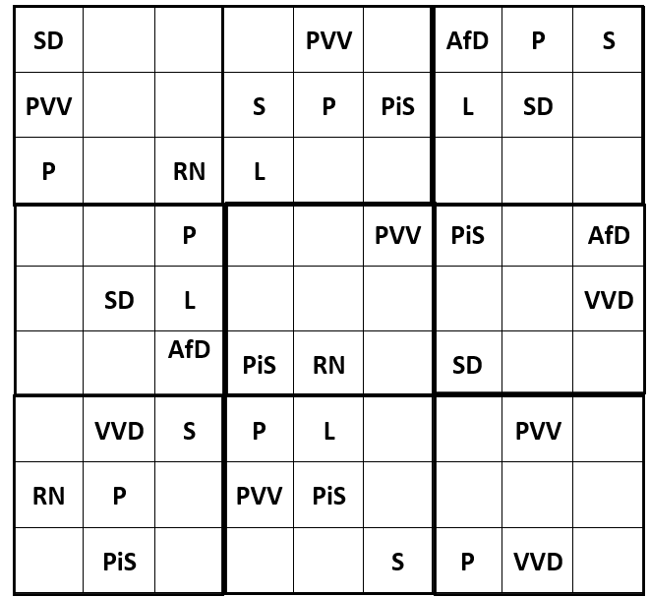
SUDOKU
Of European Populist Parties

Slide 34
UNHEARD
SUDOKU
Of European Populist Parties
FvD – Forum voor Democratie (Right wing / Netherlands): The FvD, founded in 2015 is a conservative radical right party. In the provincial elections of 2019 the party won roughly 15% of the votes. This resulted in gaining 86 seats in different provinces of which they, as of writing this, only hold 24 due to split offs. The party is also know for having frequent controversies and verbal altercations in parliament.
S – Syriza (Left wing / Greece): Syriza was founded in 2004 as a political coalition of left-wing and radical left parties. With a pro-Europeanist stance, the party also advocates for alter-globalisation, feminism, LGBT rights, and secularism. It is the second largest party represented in the Hellenic Parliament and is considered as having a left-wing populist ideology.
RN – Rassemblement National (Right wing / France): The party's platform focuses on anti-immigration policies, such as significant cuts to legal immigration and stricter controls on illegal immigration. The party has also been accused of promoting xenophobia and antisemitism.
P – Podemos (Left wing/ Spain): Podemos is a Spanish political party that stands for anti-austerity, anti-corruption, and anti-establishment views. It was founded in 2014 by Pablo Iglesias Turrión and other academics in the aftermath of the 15-M Movement protests against inequality and corruption. The party describes itself as left-wing populist and democratic socialist, and it promotes direct democracy, federalism, patriotisme, and publicanism.
L – Lega (Right wing / Italy): Lega is led by Matteo Salvini. While continuing to support autonomism, regionalism and federalism, under Salvini the League has gradually shifted focus away from Padanian nationalism and separatism. Instead, they are now concentrating on souverainism and making inroads in southern Italy.

Slide 35
SUDOKU
Of European Populist Parties
PiS – Law and Justice (Poland / Right wing): Its chairman is Jarosław Kaczyński. The party's economic policies initially leaned more towards pro-market values. In the 2005 election, the party shifted to more protectionist policies on economics. On foreign policy, PiS is Atlanticist but less supportive of European integration. The party takes a soft eurosceptic stance and opposes a federal Europe, particularly the Euro currency.
PVV – The Party for Freedom (Right wing / Netherlands):. Founded in 2006, the PVV calls for items like administrative detention and a strong assimilationist stance on the integration of immigrants into Dutch society, differing from the established centre-right parties in the Netherlands. The PVV has also proposed banning the Quran and shutting down all mosques in the Netherlands. In addition, the party is consistently Eurosceptic.
SD – Sweden Democrats (Right wing): The Sweden Democrats is a nationalist and right-wing populist political party in Sweden that is known for its strong opposition to current Swedish immigration and integration policies. The party instead supports stricter restrictions on immigration in order to protect Swedish national and cultural identity. The Sweden Democrats are also critical of multiculturalism and believe that the welfare state should only be available to Swedish citizens and permanent residents.
AfD – Alternative for Germany (Right wing): The party is known for its opposition to the European Union and immigration to Germany. It was founded in 2013 by Bernd Lucke, Alice Weidel, and former members of the Christian Democratic Union (CDU) to offer voters a right-wing alternative to the centre-right but pro-European CDU. AfD positioned itself as an economic liberal, soft Eurosceptic, and conservative party in its early years. However, the party has since taken a more hardline stance on immigration and other issues.

Slide 36
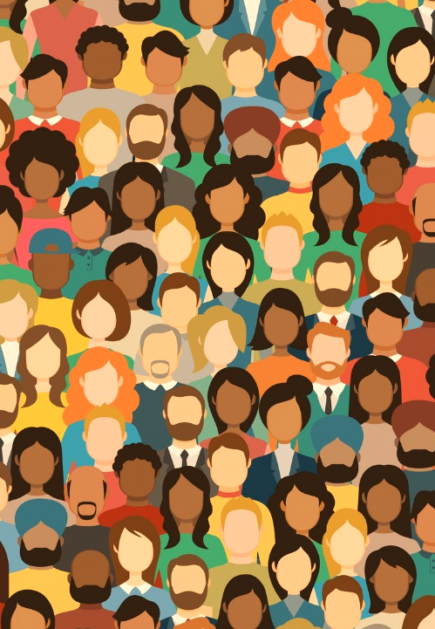
Initiatives
When people feel under or misrepresented, they tend to organise themselves in groups to compensate for this gap in representation.
In this section, we introduce you to different forms of initiatives.
The duo of Unsung + Unheard decided to compensate for the lack of representation of female compositors.
The Party for animals decided to voice those who are not able to voice their interest and represent the interest of animals and Dutch wildlife.
Lastly, the organization COC was founded to fight remaining inequalities towards LGBTQ+ people.
Innovation (2021) Équité, diversité et inclusion dans le financement des infrastructures de recherche

Slide 37
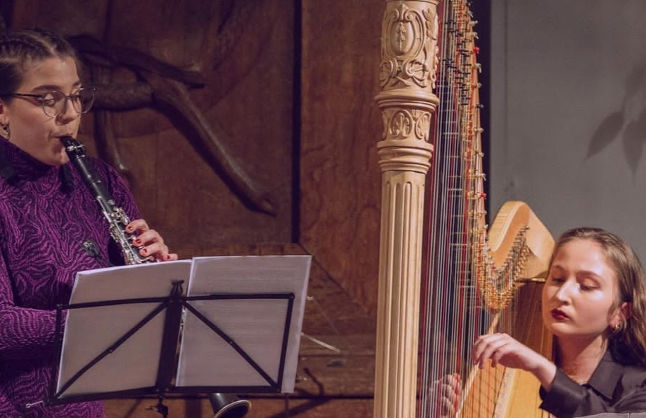
UNHEARD
UNSUNG + UNHEARD
MUSICIANS RECALL THE FORGOTTEN VOICES
To celebrate International Women's Day in 2022, students of the Conservatorium van Amsterdam presented an evening of music written exclusively by female composers.
Duo partners and friends Bibi Afshar-Shirazi and Marta Pedreira Aldao have created the program unsung + unheard , which spotlights the voices of artists previously ignored in the world of classical music. As young musicians they wanted to create a platform that not only celebrates composers who we hear less from than their male counterparts, but that also contributes to more progressiveness, diversity and equality in classical music.
30% of the profit generated by the concert were to the foundation “she said”, an international organization that helps support and further the careers of women in the music industry.
Thanks to the great success of the event in 2022, the two musicians will reiterate in 2023 for a new concert with even more inclusivity, diversity and most importantly, more music.
Did you know that only 5% of the music from the scheduled orchestral programs in the 2020-2021 season was composed by women? And even more concerning is that only 1,11% of that 5% included music composed by women of colour, including both Asian and Black Women.

Slide 38
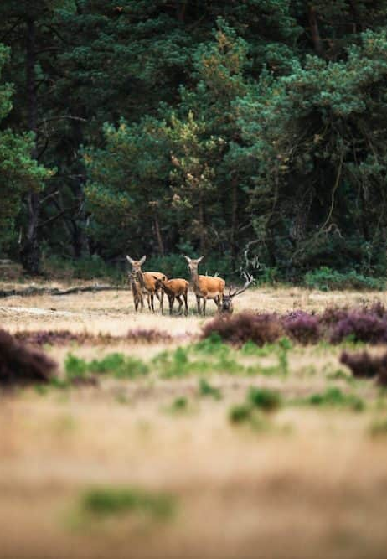

Map of Joy (2022) Watching wildlife on the Hoge Veluwe https://www.mapofjoy.nl/wild-kijken-hoge-veluwe/

Slide 39

UNHEARD
ANIMAL WELFARE AND ANIMAL RIGHTS
Written by: Bart Salemans, raadslid Partij voor de Dieren Nijmegen
Animal welfare and animal rights are often seen as subordinate to human interests. But a (drastic) revision of our relationship with animals is also in the interest of humans. Animals often depend on the actions of humans, but proportionally, humans depend on the quality of life on the Earth and therefore the state of biodiversity, nature and climate.
That quality of life is directly related to how we treat animals. In intensive farming, living and sentient animals such as pigs, chickens and cows are seen as mass-produced products, rather than the intrinsic beings they are. By endlessly breeding these animals and keeping them extremely close together, this has devastating consequences for the animals themselves (1.7 million animals are killed in slaughterhouses every day in the Netherlands).
The outbreak of animal diseases and the disappearance of large parts of rainforests due to large-scale destruction for the cultivation of animal food are just two examples of the consequences of unsustainable and endless (economic) growth, as a result of which nature, climate and biodiversity are now in serious crises and this poses a risk to the quality of life on Earth.
The Party for the Animals exists to represent the large underrepresented group of animal inhabitants in the world in politics. To be able to include the voice of the animals in future policy and thus work towards a world in which animals can live according to their nature and future generations can grow up on a liveable Earth.

Slide 40
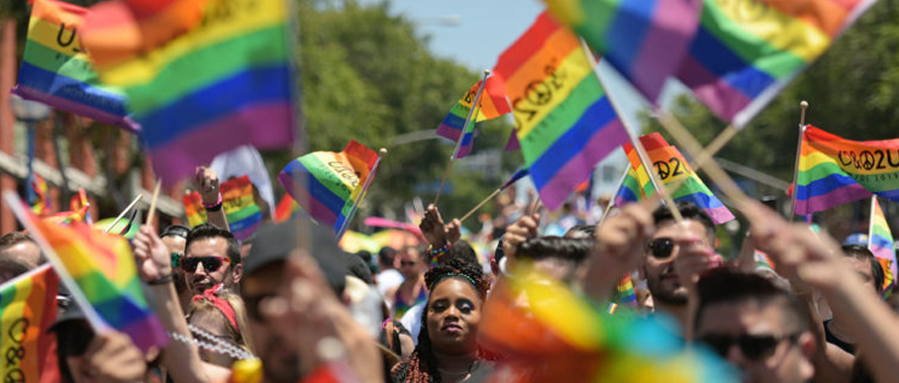
UNHEARD
Moullec, F. (2022) Près de la moitié des jeunes LGBTQ+ ont pensé au suicide l'an dernier aux États-Unis https://tetu.com/2022/05/05/sante-mentale-enquete-the-trevor-project-lgbt-suicide-depression-etats-unis/
COC
DISCRIMINATION AGAINST LGBTQIA+
In 2022, people expect the Netherlands to be “okay” with the LGBT+ community, right? Unfortunately, this turns out not to be the case in reality. To give an idea of what is currently being fought for acceptance around LGBTQ+ representation, we first go back in time.
The COC was founded in Amsterdam on December 7, 1946, then under the name Shakespeareclub. An organization that originated from the readership of the magazine 'Levensrecht', a magazine for homosexuals. In 1949, the Shakespeare Club was renamed the Culture and Relaxation Center, or the COC. In the first decades of the COC's existence, it focused on organizing shelter and social activities for lesbian, gay and bisexual people. COC is emerging in many more large cities besides Amsterdam. The organization was committed to abolishing the discriminatory article 248-bis of the Penal Code. It was stated that sexual contacts with someone of the same sex between 16 and 21 years are punishable, while heterosexual contact was allowed from the age of 16. It was abolished in 1971.
In the eighties and nineties of the twentieth century, the COC mainly focused on combating the HIV/AIDS epidemic and the creation of anti-discrimination legislation. There were targeted prevention campaigns and specific assistance to those in need.
From the first years of the 21st century, the COC has been campaigning for a third phase in LGBT+ emancipation. Now the COC argues for the pursuit of social acceptance. The non-discrimination standards enshrined in the law must now also take hold in the capillaries of society. For the time being, the highlight of this mission is that information about LGBT+ people has become a mandatory part of the school curriculum in every school in the Netherlands since 2012, following years of pleading by the COC. At the insistence of the COC, the government also developed a strong LGBT+ emancipation policy. Apart from sexual diversity and identity, the COC stands up for gender identity. So that regardless of all the intersections that a person has, you can be who you are.

Slide 41

For writing for us
For helping us
For reading our magazine
For answering our survey
THANK YOU !
For taking the time to talk to us
For following our Instagram
@Unheard_ru

Slide 42
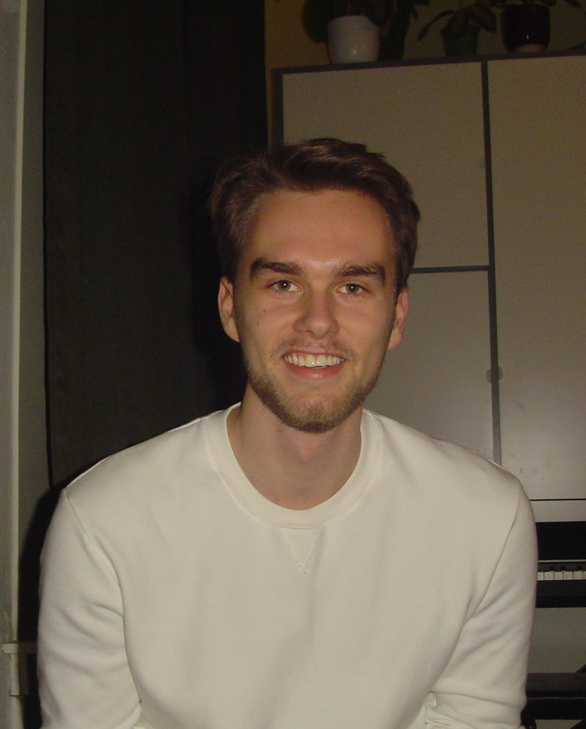
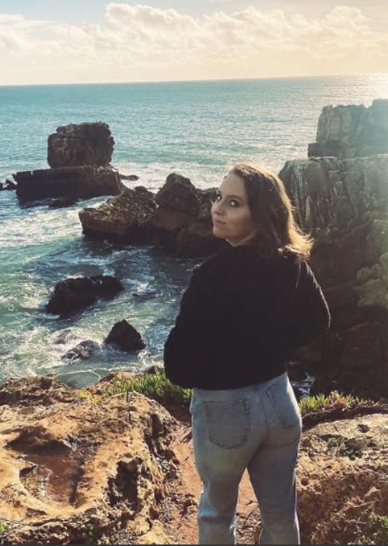
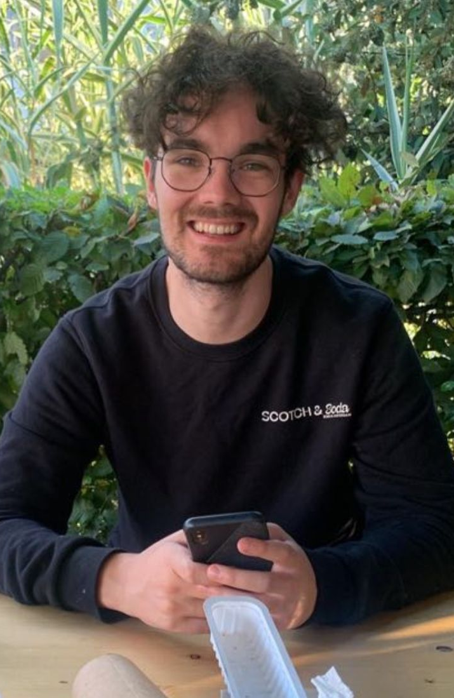
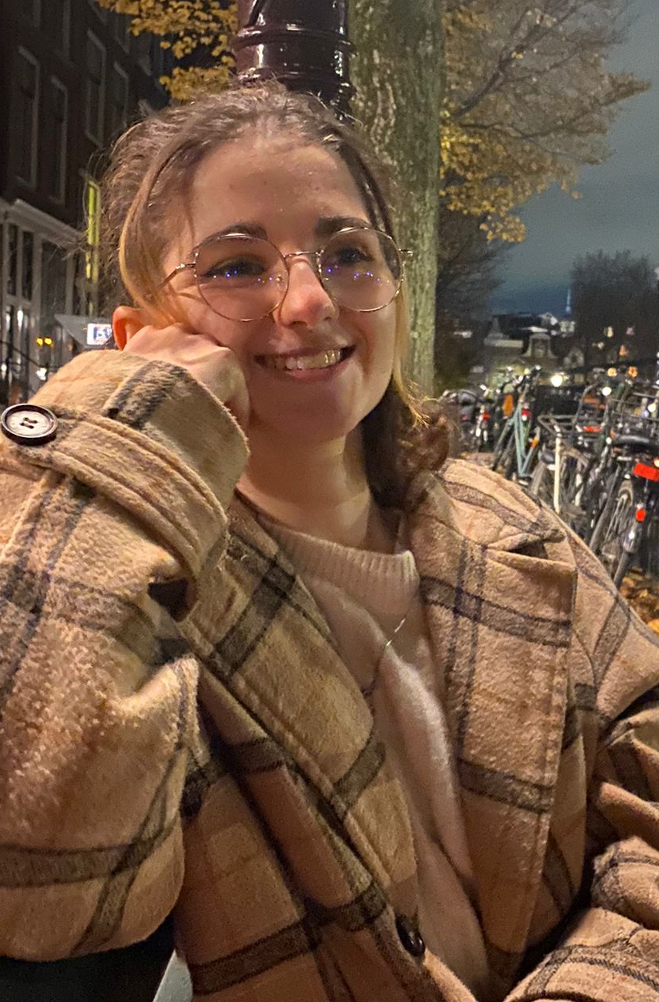
MEET OUR EDITORS
Hi, my name is Rogier (he/him), I am a 21 year old master student in the Gender equality track of political science. Besides that I am a volunteer at COC Nijmegen where I give workshops around gender- and sexual diversity to primarily (highschool) students. I also work as a tutor for highschool students and my favourite book I read this year was 'Swimming in the Dark' by Tomasz Jedrowski
I am Isabelle (she/her), 25 years old and doing the master course of gender equality, diversity and inclusion in politics. Next to that, together with a friend of mine we recently started our webshop called MyBootyFitness.com. I am not doing any cool volunteer work like my fellow class mates, however, I support the LGBTQI+ community by spending most of my DUO loan on drinks at the local gay bar in Nijmegen.
My name is Pelle Depla (He/him) and I am a master student in the political science track comparative politics. Besides that I am a working for the Dutch Labour Party in the city council in Nijmegen. In my spare time; I am a food and music enthusiast.
Hello, my name is Camille (She/ They) and I am 22 years old, I am a student in the gender track of political science but I also volunteer for the Feminist Club of Amsterdam.
Apart from this I am a bartender and I am reading “Swimming in the Dark” thoroughly recommended by Rogier.

