Slide 1
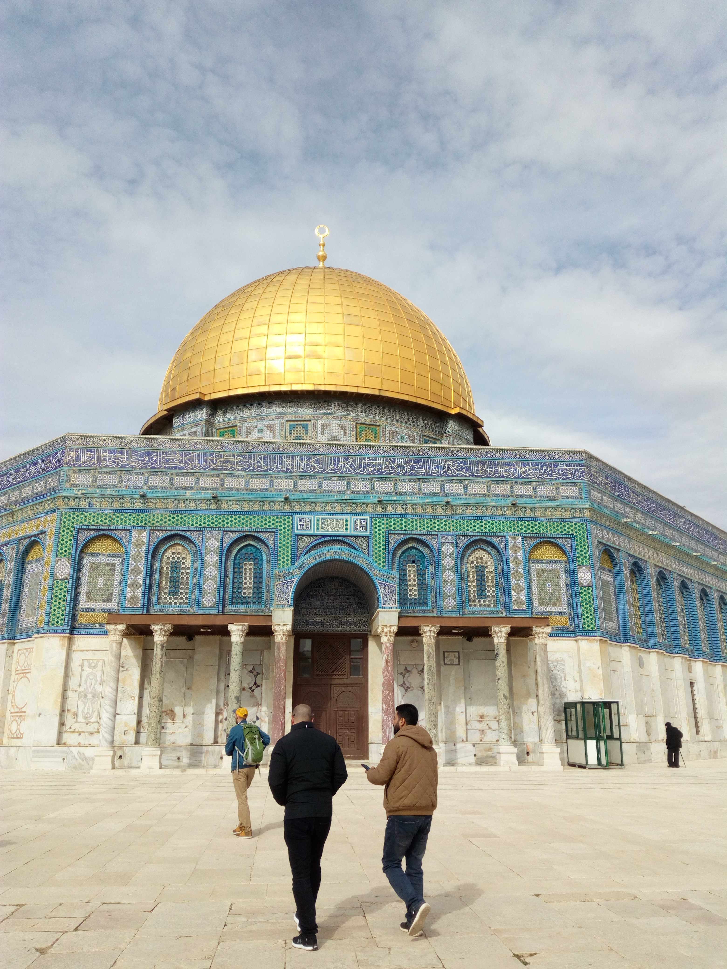

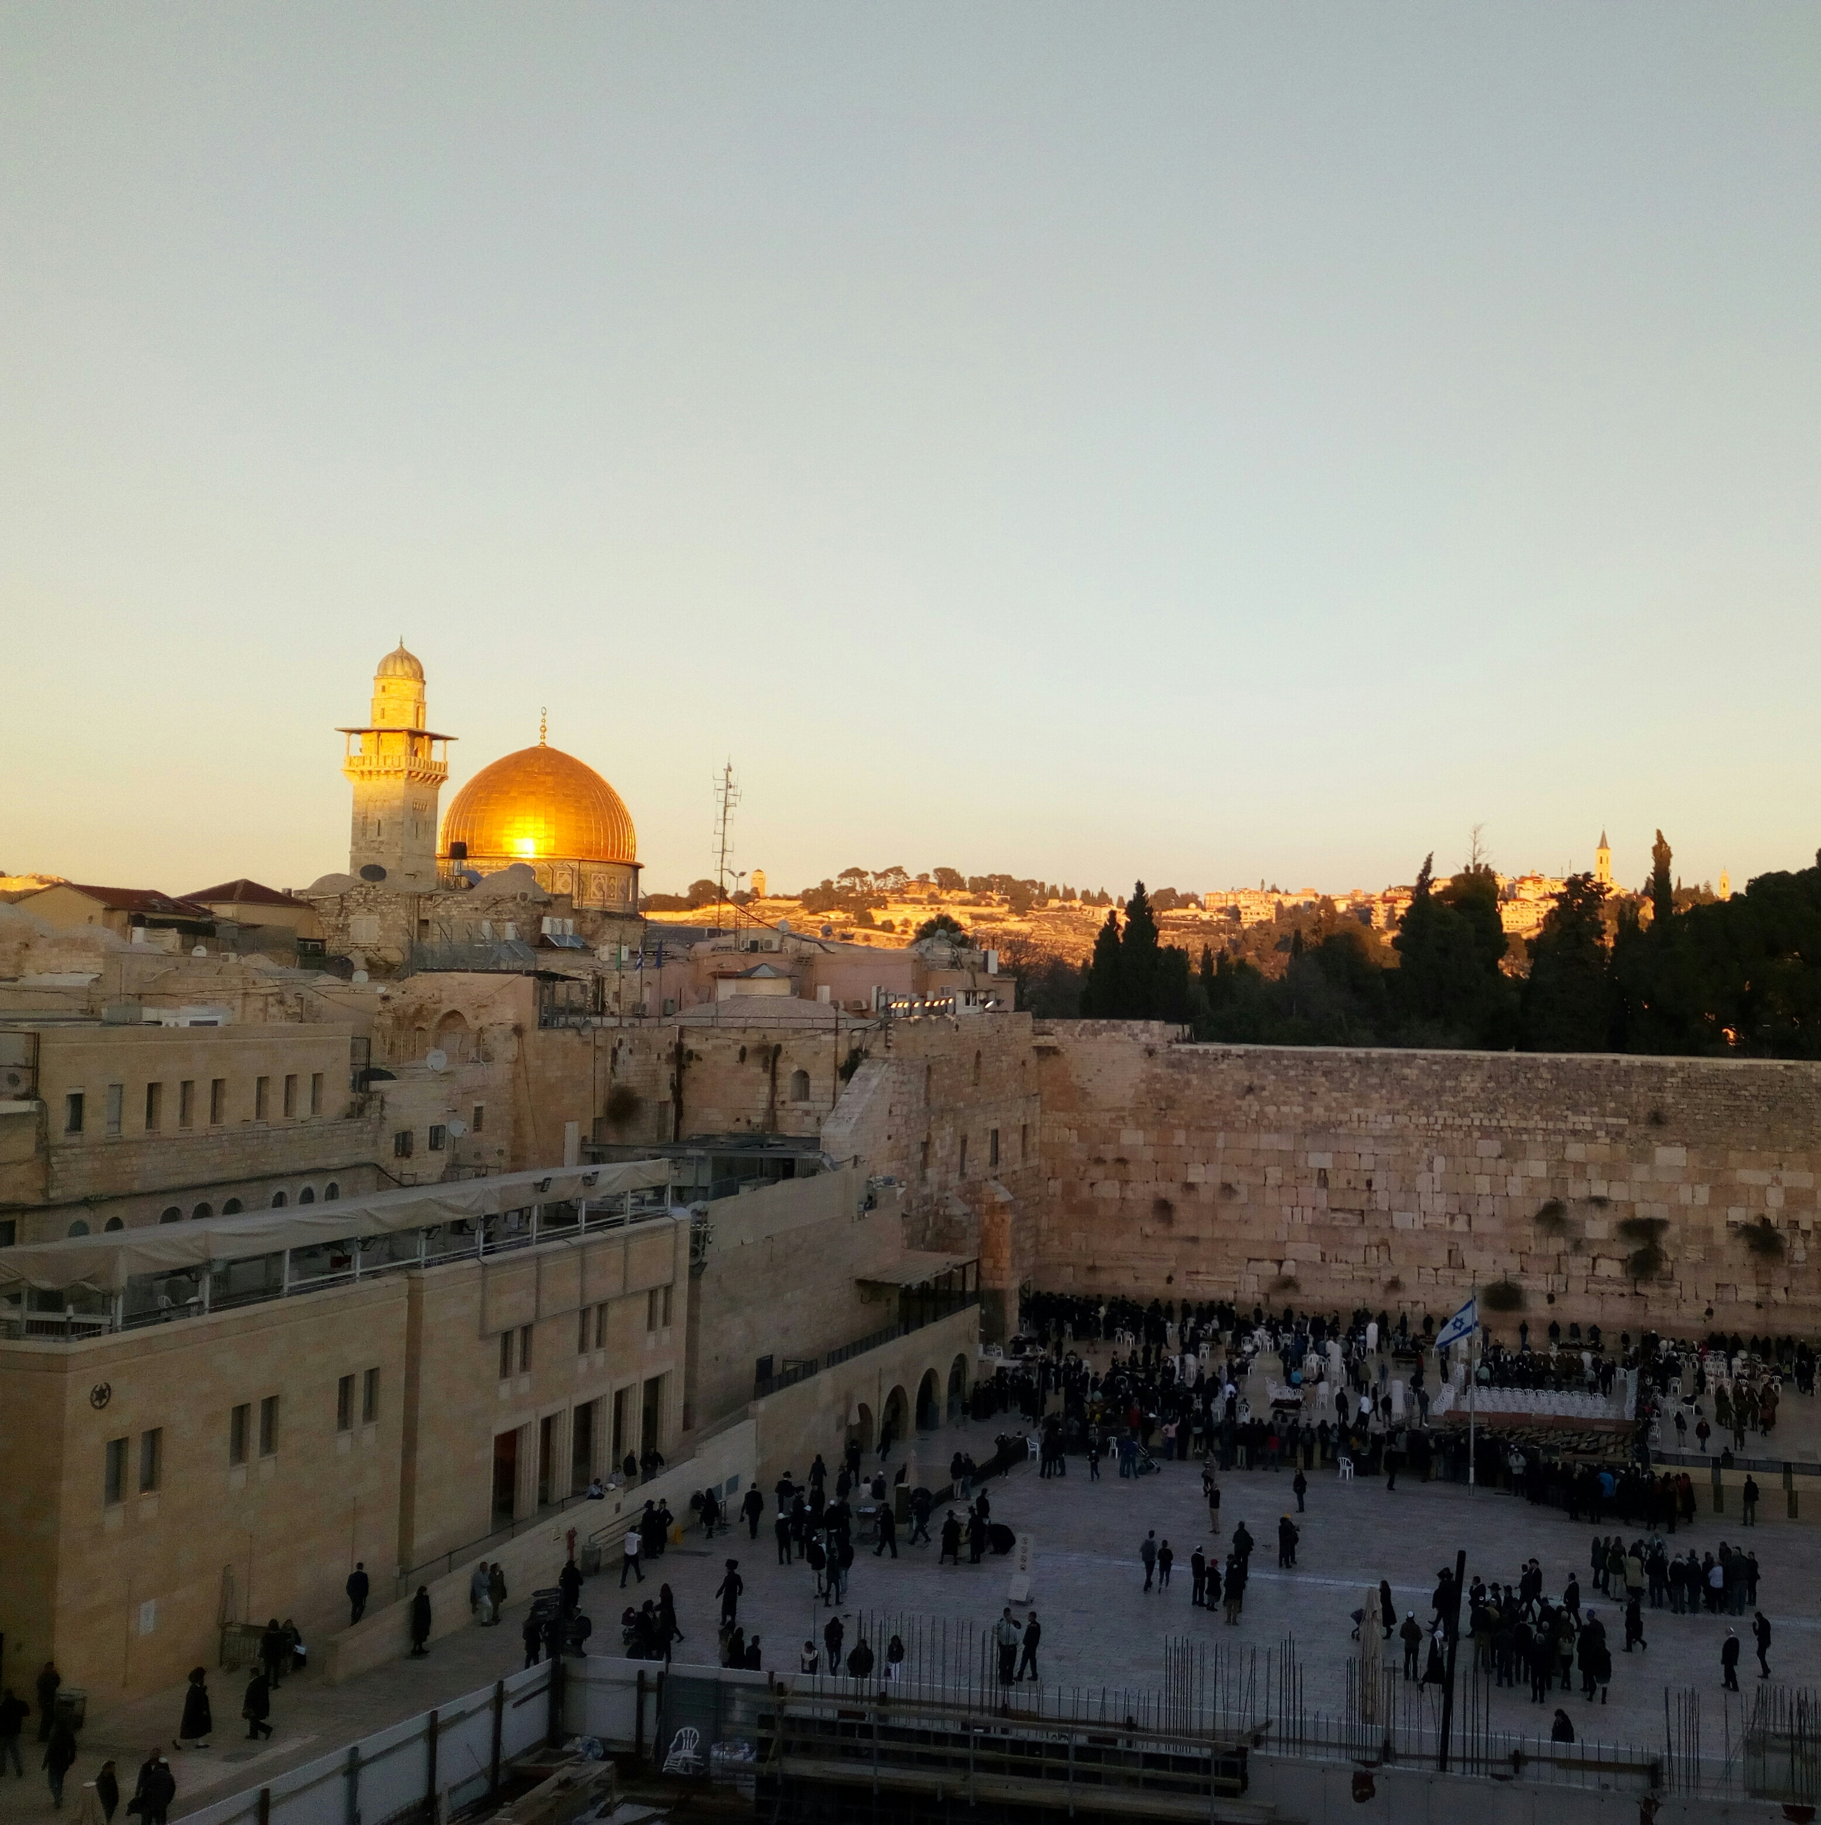
Possibilities for a Short Stay Abroad
International Office Philosophy, Theology and Religious Studies
Treja Wilkens & Svenja van der Tol

Slide 2
What is an International Short Stay
Minimum 1 week, maximum +/- 6 weeks
International learning environment
2023/2024: online or off-line
Summer/Winter Schools
Course at a Dutch Scientific Institute Abroad (Rome, Florence, Athens, Rabat, Cairo, St. Petersburg)
Research institutes

Slide 3
Search for a programme
International Office PTRS website
  PTRS Summer Schools outside of the Netherlands
  PTRS Summer Schools within the Netherlands
  We publish a selection of Summer/Winter Schools, but we do not have direct contact with the organising teams.
Website Central International Office: for Summer and Winter Schools (some have special offers for RU students → read the instructions for that carefully!)
Website Summer Schools in Europe
Website Go Abroad
Short courses portal
Courses offered by a NWIB
Search directly on the website of a university

Slide 4
Summer School grants
Grants for Summer/Winter Schools
Within the Netherlands or outside of the Netherlands (faculty + central)
Online (2023-24) or on campus events
For all PTRS (full time student at Radboud University)
Independent of study phase or year
Grant will be issued once during studies at Radboud University
Organising university/organisation does not have to be a partner university or a university at all

Slide 5
Some examples
Happiness: east and west (Hong Kong)
German philosophy: from Kant to Habernas (Berlin)
Love and sex in the digital world: philosophy, ethics and theology (Tartu)
Philosophy in east Asian Literature (Seoul)
Philosophy of mind and ethics: dilemmas and thought experiments (Leeds)
Buddhist mindfulness and care (Amsterdam)
… And many more!

Slide 6
How to make a choice?
Your preference based on:
  Subject (related to your degree or not)
  Location
  University
  Language
  …

Slide 7
Summer School Grants Radboud University
10 Grants available for PTRS students: € 750,- in Europe, €1000,- outside Europe, € 750,- online
Max. €375 per week for a Summer/Winter School online (enrolment fee)
Max. €375 per week for a Summer/Winter School within Europe
Max. €500 per week for a Summer/Winter School outside of Europe
Final grant allocation is calculated on the basis of the number of days of your Summer/Winter School abroad.
Max. 75% of costs for travel, housing, participation fee, mandatory excursions
Max. reimbursement is 2 weeks, you may participate in a short educational stay abroad for a longer period.
First come, first serve

Slide 8
Summer School Grant Requirements
You are enrolled as a (fulltime) student at the Faculty of PTRS at Radboud University;
The duration of your Summer/Winter School abroad is at least 1 week (consecutive);
The Summer/Winter School takes place abroad or online;
You will be awarded European Credits (ECs);
You have not received a Summer School grant yet, during your studies at Radboud University;
You will leave in more than 2 weeks time;
You have permission from the Faculty International Office;
  Send your application with a motivation letter, recommendation letter and description of the Summer/Winter School to internationaloffice@ftr.ru.nl
After approval of your faculty International Office, fill in the online application form and submit your Grant Agreement (filled out by you) and Letter of Approval (issued by International Office)
After the Summer/Winter School, submit a Certificate of Attendance and report

Slide 9
Summer Grants NL
4 grants of € 500 available
Physical or online Summer Schools within the Netherlands (except Radboud University)
Max. 75% of costs for participation fee, literature, housing, etc.
First come, first serve

Slide 10
Summer School Grant NL: Requirements
You are enrolled as a student at the Faculty of PTRS at Radboud University;
The Summer/Winter School takes place within the Netherlands or is organised by a Dutch university (except Radboud University);
There is an international focus (topic, participants, teachers);
You will be awarded European Credits (ECs);
Your application is relevant for your studies and supported by a professor or study advisor;
You have not received a Summer School grant yet, during your studies at Radboud University;

Slide 11
Summer Grant PTRS
Email your application to IO PTRS and attach the following documents:
  A description of the programme or link to the website
  A short motivation letter
  An overview of the expected costs (Dutch template)
  A recommendation letter by a professor or student advisor
In case of approval, you will receive a confirmation by email
After participation, send the following documents to receive your grant:
  Certificate of Attendance stating the obtained ECs
  A financial realisation (template above) including proof of payments (invoices, bank transfers, etc.)
  A short report of your Summer School
→ It is possible to receive a 50 % advance payment of your grant.

Slide 12
Questions?
About the programme: contact the organising team
About practical matters: contact internationaloffice@ftr.ru.nl
About the Summer Grant: contact Svenja van der Tol via internationaloffice@ftr.ru.nl
About adding your course to your transcript of records: contact the Board of Examiners

Slide 13
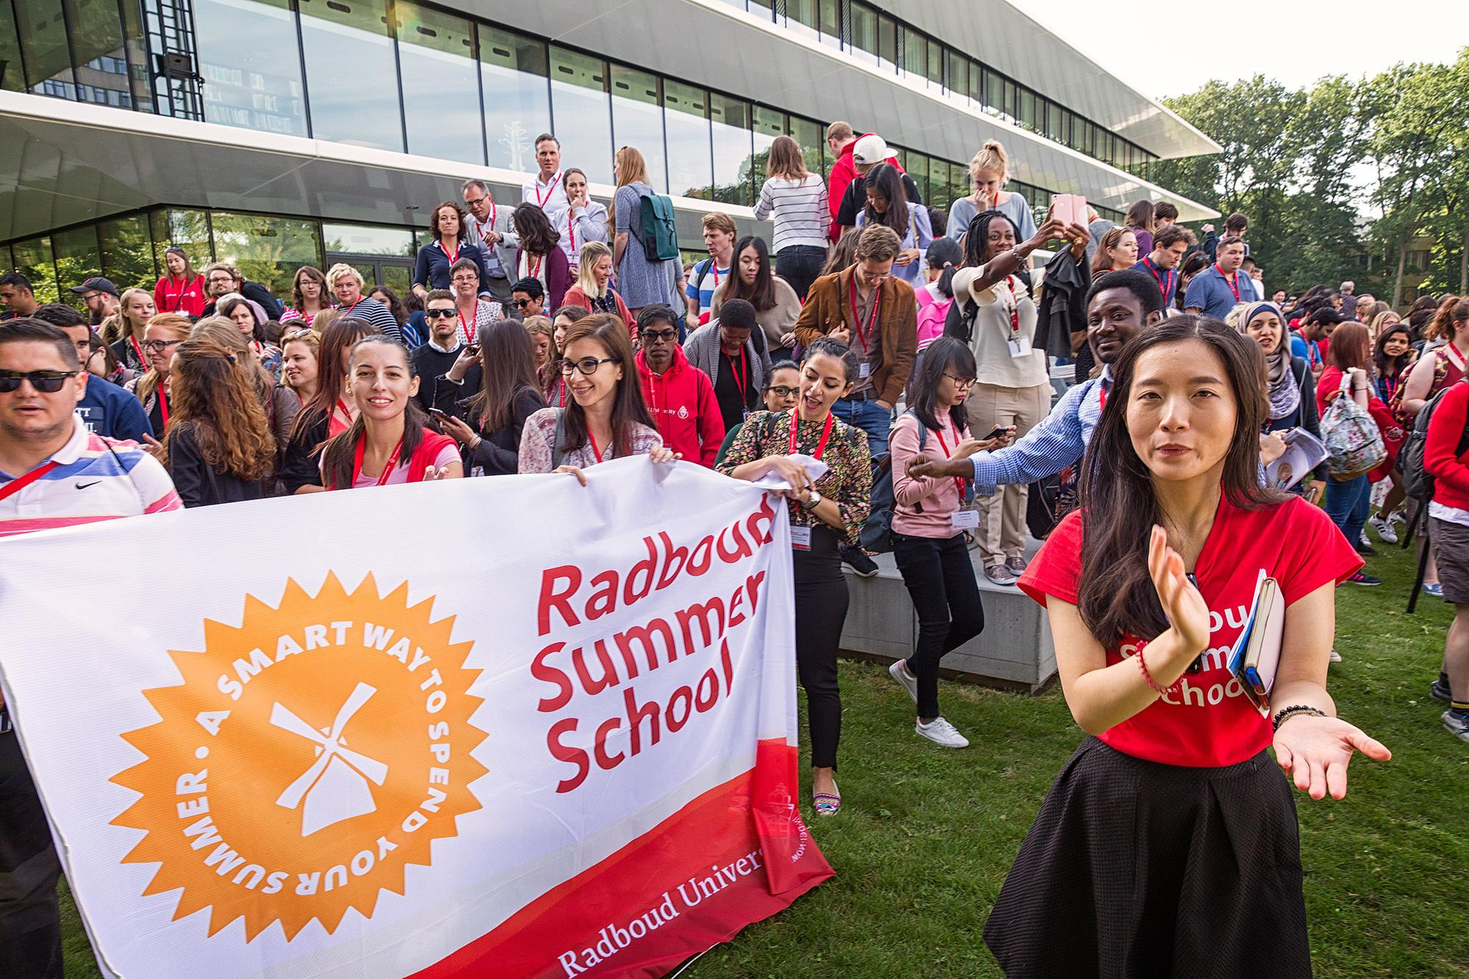
Enjoy your Summer/Winter School!

