Slide 1

Go abroad: why, how and when?
Faculty of Arts
9 October 2025
Amy Ruiters , Treja Wilkens & Linsey van den Heuvel
internationaloffice@let.ru.nl

Slide 2
Warm Up Questions

Slide 3


Slide 8
How to fit your programme?
Stay abroad fits your 3-year BA programme
If a stay abroad means missing (major) courses, the programme usually offers alternatives (distance learning, SM2, replace course)
Third year BA or MA student? Stay abroad possible in additional semester; consult your study advisor
Always consult with International Office Arts if you want to go abroad
Notes:
Cohort 2023 – buitenland minor samenhangend pakket (vakken niet gehaald? Vervangen hier, moet samenhangend)
26/27 denktank daarna niet meer
15 EC per SM – dus major vakken moeten vervangen worden (regeling 1 juli 2026)
Studenten hoeven van tevoren niet iets te doen om de major vakken te organiseren i.v.m. buitenlandverblijf – gericht op nominaal studeren
Cohort 2024 – 30 EC vrije ruimte (geen samenhang nodig) – check FEX of nodig indienen
Cohort 2025 – B3 vrije ruimte 30 EC (geen samenhang) kunnen “buitenlandminor” kiezen- aanrader
Minder EC kan
Romaans – 15 EC invullen major buitenland in taal studie / vervangen – afstemmen Rene Gerritsen & 15 EC vrij (niet CIW)

Slide 9
Where do you want to go?
Notes:
Maybe change it to: Where would you like to go?

Slide 10

Destinations study abroad
Exchange agreements: stimulate + facilitate exchange
Europe: >20 countries, > 100 agreements
Outside Europe: almost every continent
How to choose a destination: preference, courses, study programme, language skills
All destinations for students in the Faculty of Arts
Workshop: “How to choose your perfect destination”
Tuesday 11 November 12:30-13:30, E 2.12
Notes:
Location workshop?

Slide 11

More info on partner universities?
Check the information in the Fact Sheets
Website universities
Student experiences: testimonials

Slide 13

Internship Abroad
Difference between study abroad and doing an internship
Note: internship is usually 10 EC
Look for internship yourself | help from Career Service Arts | grant from Erasmus+/Radboud
Career Service Arts

Slide 14

Short Stays ABroad
We stimulate shorter, credit-bearing courses abroad
Grant available
Summer school | Winter school | NWIB | non-Dutch university
NIKI & KNIR
Info session: 15 October, 14.30-15.30, E9.14
Notes:
NWIB = Nederlands Wetenschappelijk Instituut in het Buitenland / Dutch Scientific Institute Abroad
NIKI = Nederlands Interuniversitair Kunsthistorisch Instituut in Florence
KNIR = Koninklijk Nederlands Instituut Rome

Slide 16

Financing a Stay abroad
Monthly costs differ a lot per destination
Average €950 p/m
How to finance?
Grant
OV compensation (€109,- p/m in 2025)
‘Uitwonendenbeurs’ DUO
Room sublet bonus (€350,- in 2024)
Important: you pay tuition fees at RU, not at partner university
Notes:
OV compensatie aanpassen?
Room subletting bonus available next year?

Slide 17
Scholarships
For partner universities/internships: Erasmus grant OR Individual Travel Grant
Non-competitive grants: if you are eligible and hand in documents, you will receive the grant
Your destination determines for which grant you can apply

Slide 18
Erasmus grant
Grant applicable for study or internship in Europe and the United Kingdom
Allowance study between €270 - €390 p/m (dependent on destination)
Allowance internships between €420 - €540,- p/m (dependent on destination)
Erasmus grant for UK: maximum grant for 100 days
Top ups for inclusion (low income/disability) and green travel
More info on the Erasmus grant

Slide 19

Individual Travel Grant
Mainly used for destinations outside of Europe
Erasmus grant not possible
Stay abroad of minimum 2 months for credits
Allowance: €300 p/m, max. 4 months (outside Europe)
More info on the ITG

Slide 20
NL Scholarship
Allowance is €2500,-
Limited number of grants available
Students who are selected for this grant will receive more information
More info (in Dutch)
Notes:
At RU it is a loting for specific destinations right?

Slide 21

Short Stay GRant
For short stays abroad that are academically linked to your study programme
Allowance: max. €375,- p/w within Europe, max. €500,- p/w outside Europe (max. 2 weeks)
15 grants available for Faculty of Arts; first come first serve
More information on the Short Stay Grant

Slide 22

Application procedure study abroad
Digital application via Osiris
Attach motivation letter
Attach budget overview
Top 4 of universities
Information session on Thursday 11 December, 12:30-13:30, E 2.12

Slide 23
Application deadlines
Before the academic year you want to go abroad
14 January (23:59)
Destinations outside of Europe
29 February (23:59)
Destinations within Europe + UK
9 September (23:59)
Students German Language and Culture
Internships + short stays can start throughout the year, so no specific deadline

Slide 24
What happens after your application in Osiris?
Placement letter in February/March
First, WE: nominate you at host university & nominate you for applicable grant
Then, YOU: apply as exchange student at host university & hand in application documents
Information session in February/March, date and location tba

Slide 25
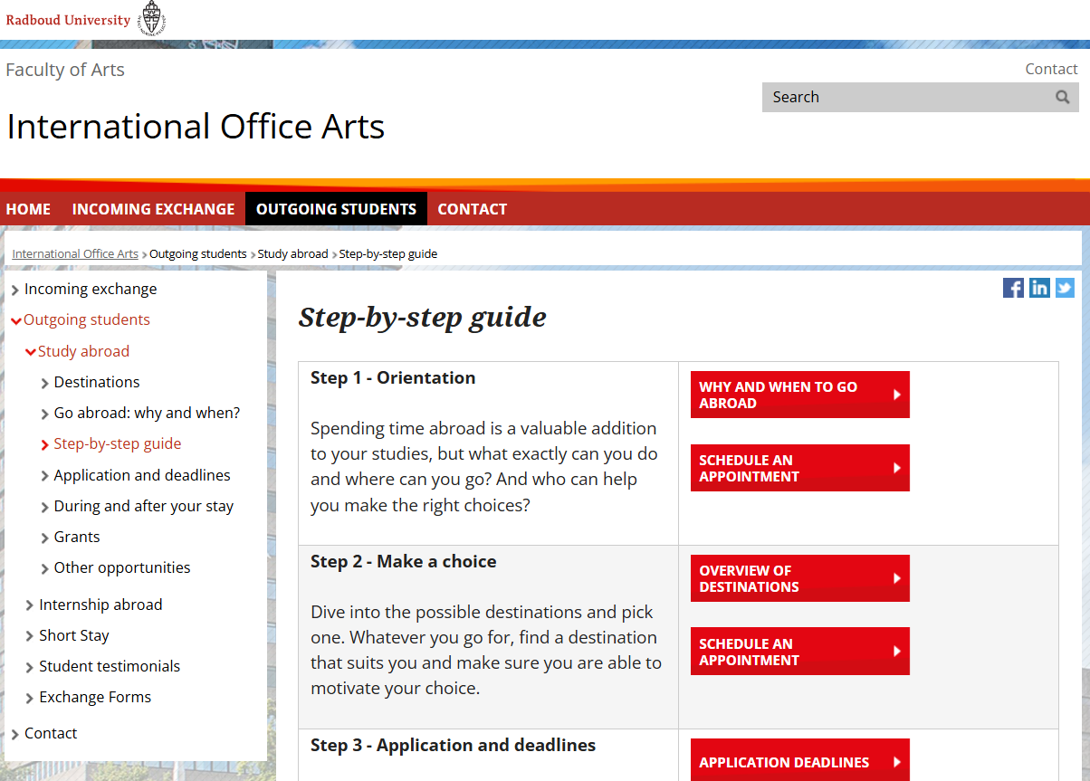
Need help?
Check our website for more information
Questions? Schedule an appointment!

Slide 26
After today
Find out how an international learning experience fits your programme
Decide which international learning experience suits you best: study, internship, short stay?
Read student experiences
Join our info sessions
Sure about going abroad? Keep the deadlines in mind

Slide 27
International Café
Scheduled information sessions:
Spanish(-speaking) destinations, Thursday 16 October, 15.30 – 16.30, E 2,05
How to choose your perfect destination, Tuesday 11 November, 12.30 - 13.30, E 2.12
How do I apply for a stay abroad? Thursday 11 December, 12.30 - 13.30, E 2.12

Slide 28

Now: student panel

Slide 29
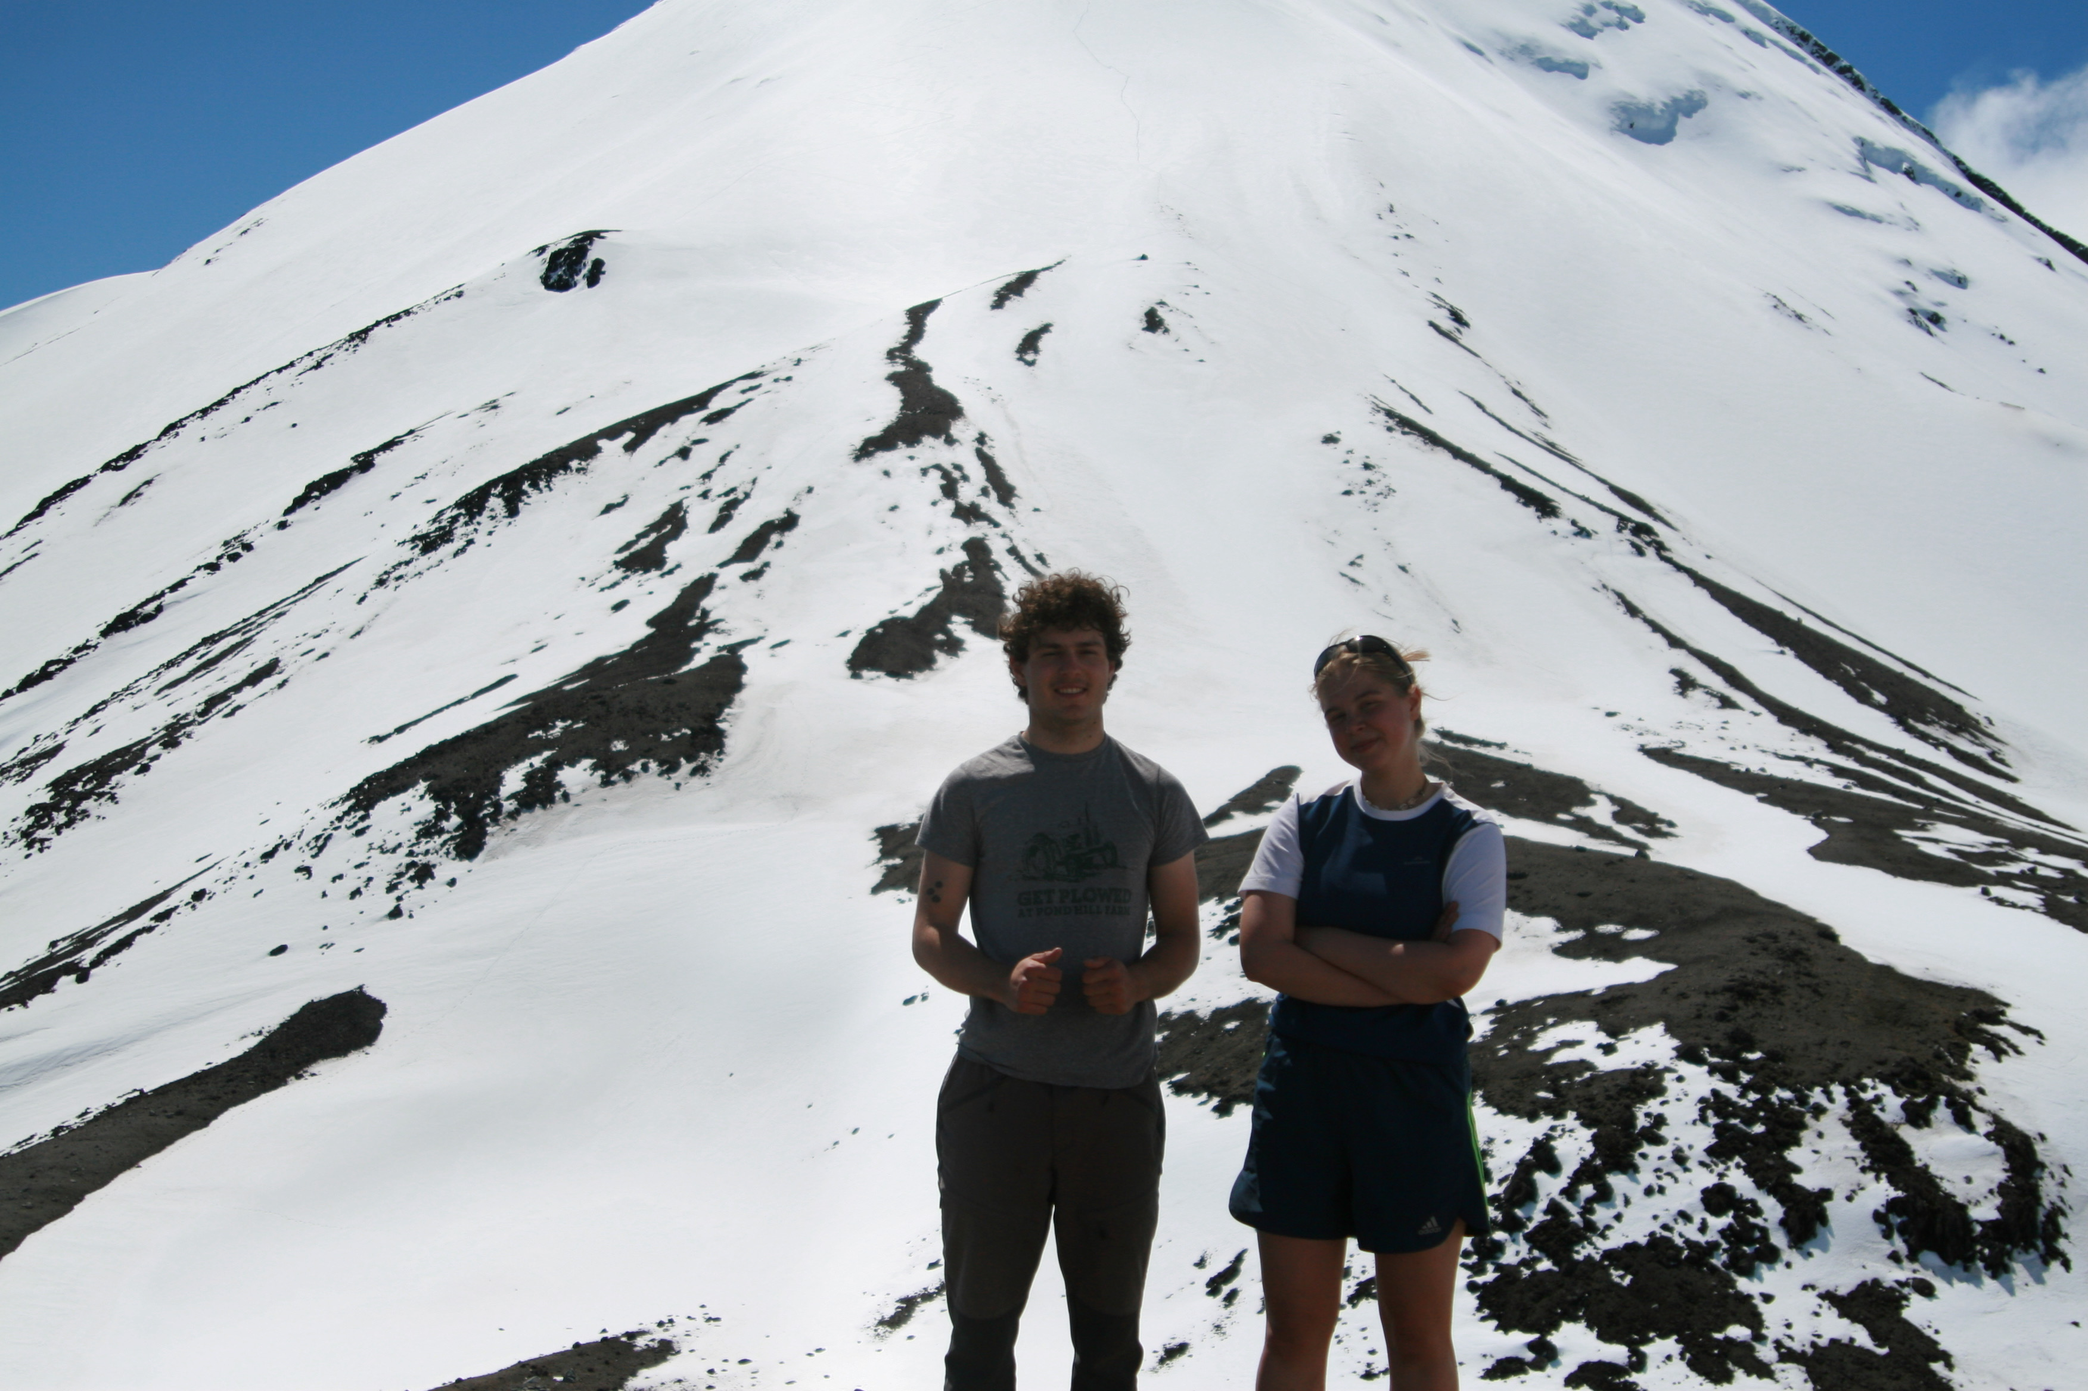
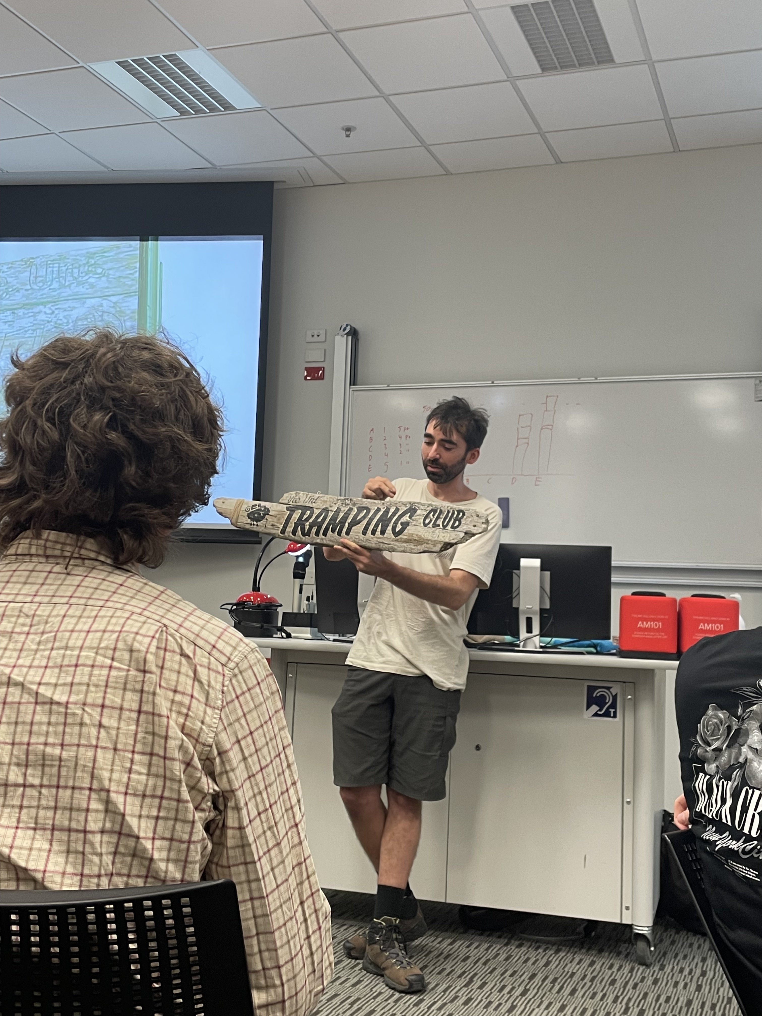

Student panel
Sarah: Granada (Spain)
Cita: Leuven (Belgium)
Marta: Wellington (New-Zeeland)
Dana: Springfield, Illinois (USA)

