Slide 1
Going abroad?
18-11-2025
Tom Kortsmit – International Office Arts
Arts and Culture Studies

Slide 2

Everything you need to know
Going abroad?
You can go abroad for different reasons
A study abroad (1 semester or sometimes a full year)
A short stay (a minimum of 5 days)
A summer/winter school
An internship
You need to choose your destination before the following deadlines for a study abroad in 26/27:
14th of January – Outside of Europe
28th of February – Part of Europe (including the UK)
Do I even want to go abroad/how do I choose a destination?
Listen to our podcast about that! (sadly it is in Dutch)
Go to our website and look at fact sheets and student testimonials! (https://www.ru.nl/facultyofarts/io/)

Slide 3


ACS
Universidad de Guanajuato (MX)
(Limited) accommodation on campus.
“Everyone is super kind and interested in your journey, both students and teachers.”

Slide 4
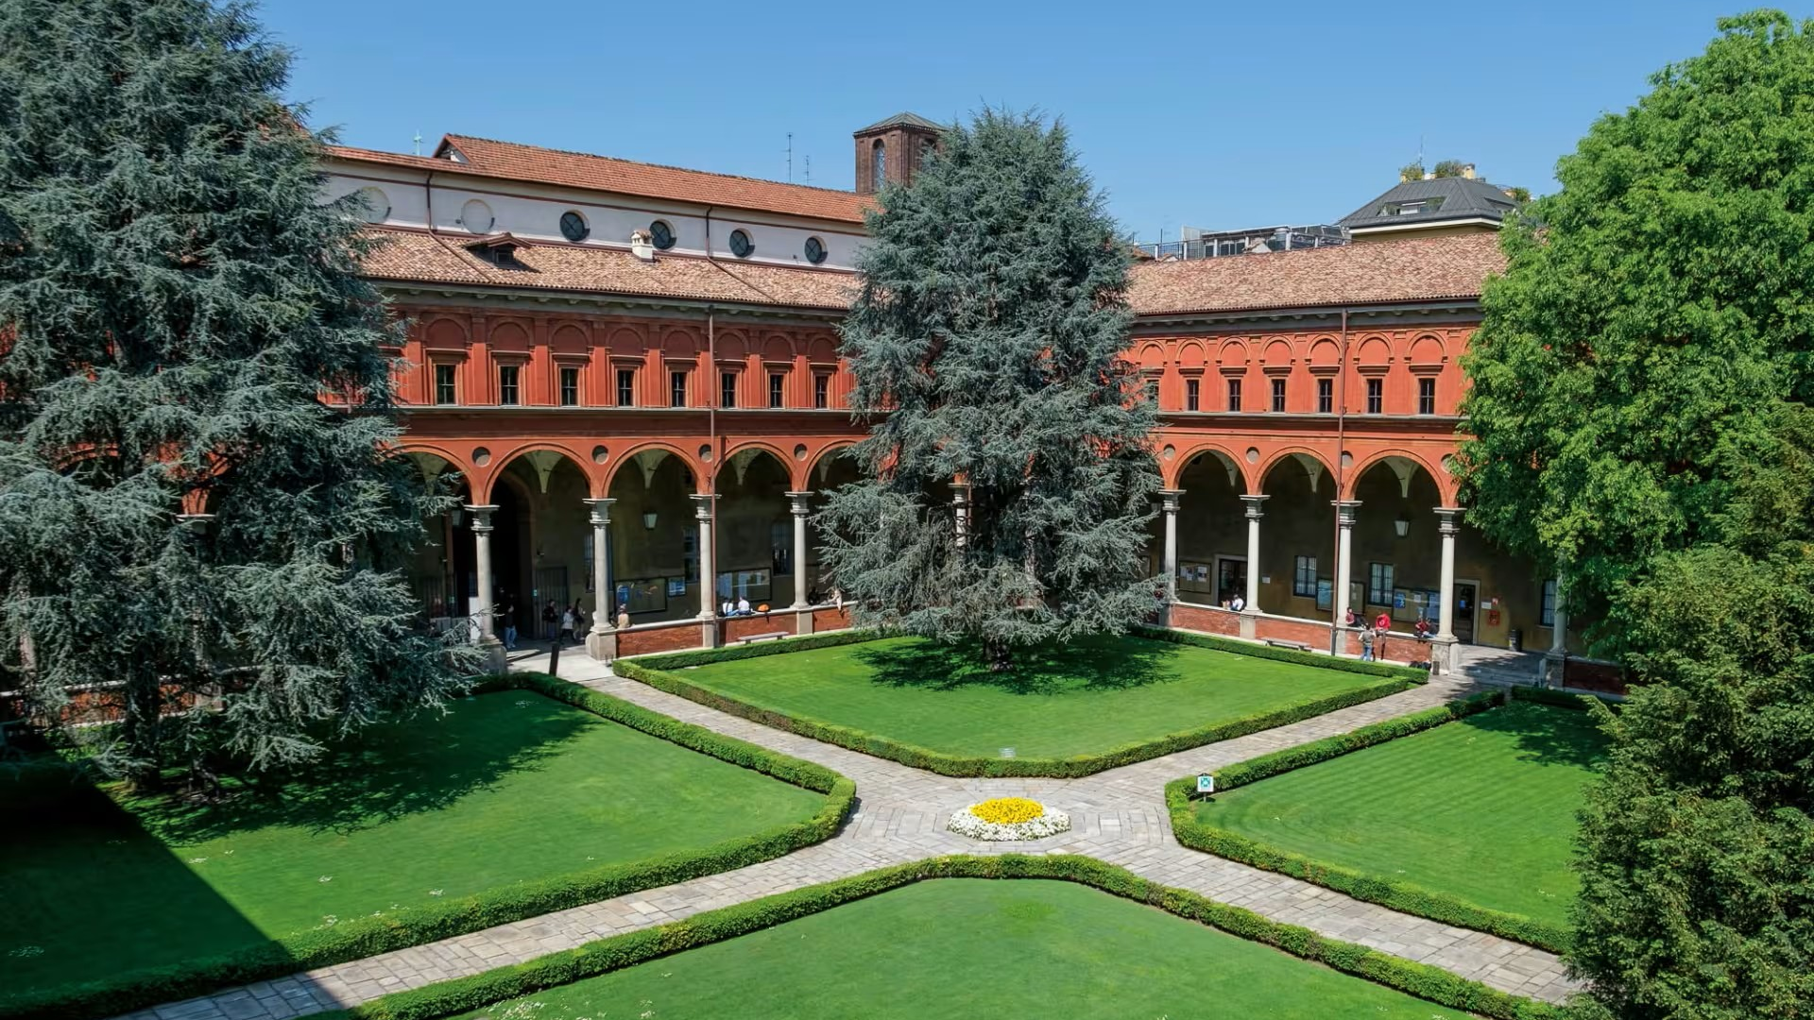
ACS
Universita Cattolica del Sacro Cuore (IT)
(Limited) accommodation on campus.
“Support and communication were nicely provided, with the 'international office' available daily and also available through emails.”

Slide 5


ACS
Institut Catholique de Paris (FR)
(Limited) accommodation provided by the university.
“The university helped us with making new contacts by pairing us with a 'buddy' that would show us things in and around the campus.”

Slide 6

ACS
Université de Lille (FR)
(Limited) accommodation on campus.
“Lille is extremely nice and has amazing cafés, bars and places to eat.”

Slide 7
More information?
Go to our website: www.ru.nl/facultyofarts/io/
Send us an email: internationaloffice@let.ru.nl
Book an appointment: click here

