Slide 1
Going abroad?
13-11-2025
Tom Kortsmit – International Office Arts
English Language and Culture

Slide 2

Everything you need to know
Going abroad?
You can go abroad for different reasons
  A study abroad (1 semester or sometimes a full year)
  A short stay (a minimum of 5 days)
    A summer/winter school
  An internship
You need to choose your destination before the following deadlines for a study abroad in 26/27:
  14th of January – Outside of Europe
  28th of February – Part of Europe (including the UK)
Do I even want to go abroad/how do I choose a destination?
  Listen to our podcast about that! (sadly it is in Dutch)
  Go to our website and look at fact sheets and student testimonials! (https://www.ru.nl/facultyofarts/io/)

Slide 3

ETC
University of Essex (UK)
Guaranteed accommodation on campus.
“The university had a good variety of choices when it came to the courses they offered.”

Slide 4

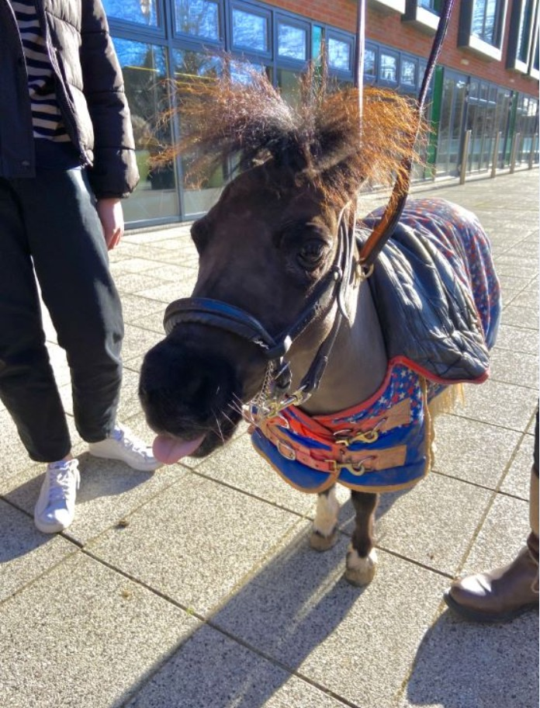
ETC
University of Leeds (UK)
Guaranteed accommodation on campus.
“I was really happy with the way the host university was organized.”

Slide 5


ETC
University of Lincoln (UK)
(Limited) accommodation on campus (but 90% chance you get a room anyways).
“You are 100% making the right decision by applying for an exchange to this place.”

Slide 6
More information?
Go to our website: www.ru.nl/facultyofarts/io/
Send us an email: internationaloffice@let.ru.nl
Book an appointment: click here

