Slide 1

Faculty of Economics Kasetsart University Bangkok, Thailand

Slide 2

Welcome to the City of Angels กรุงเทพมหานคร

Slide 3
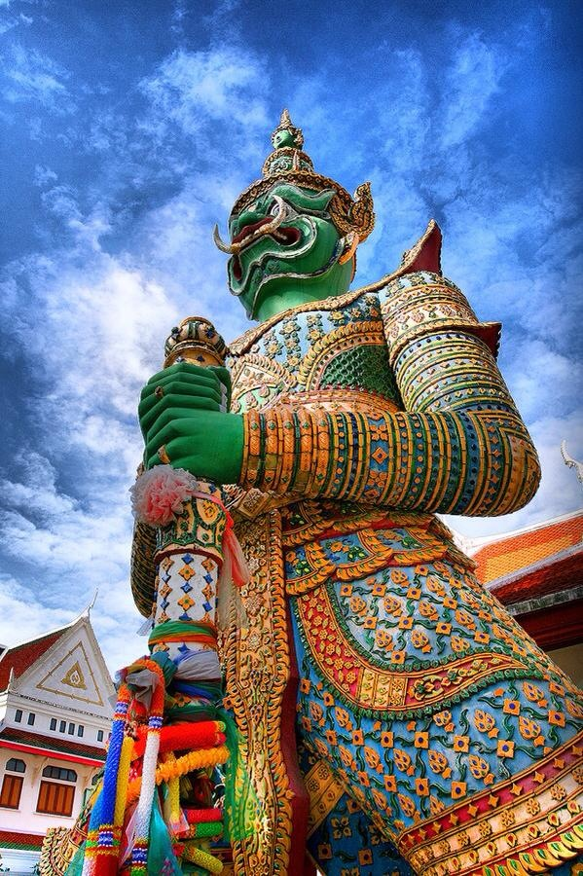



Slide 4
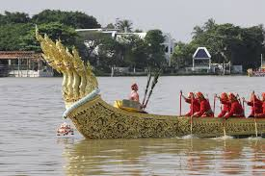
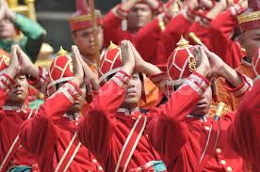
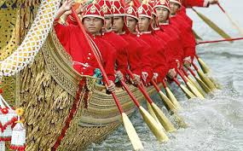
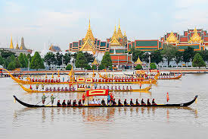

Slide 5
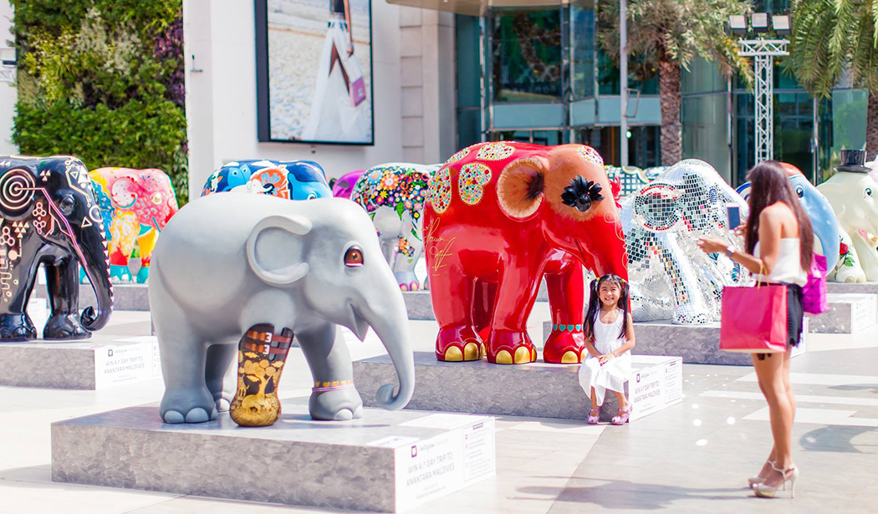
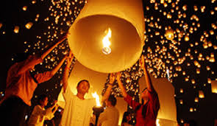
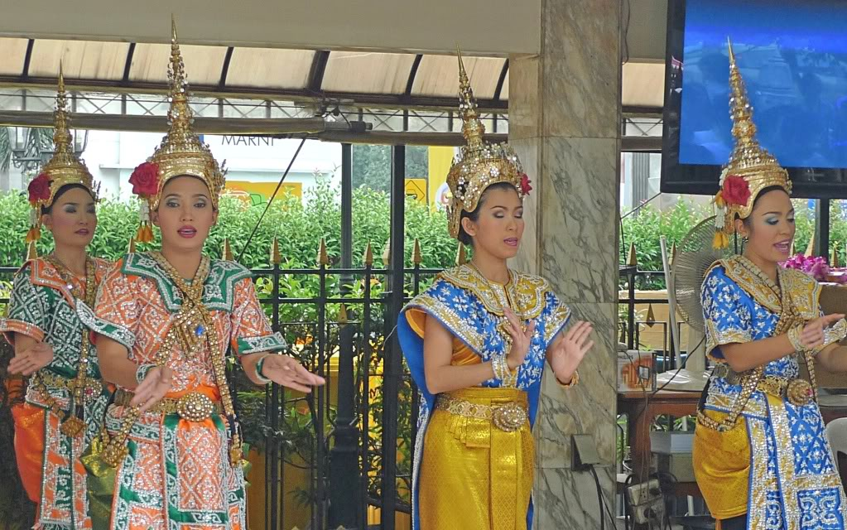

Slide 6

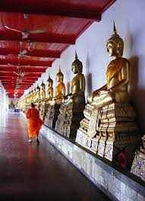


Slide 7
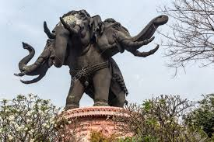
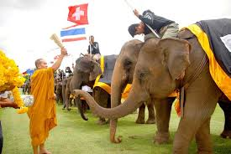
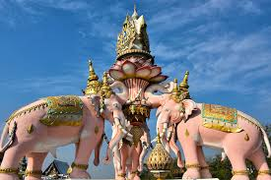


Slide 8



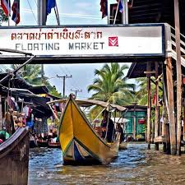

Slide 9
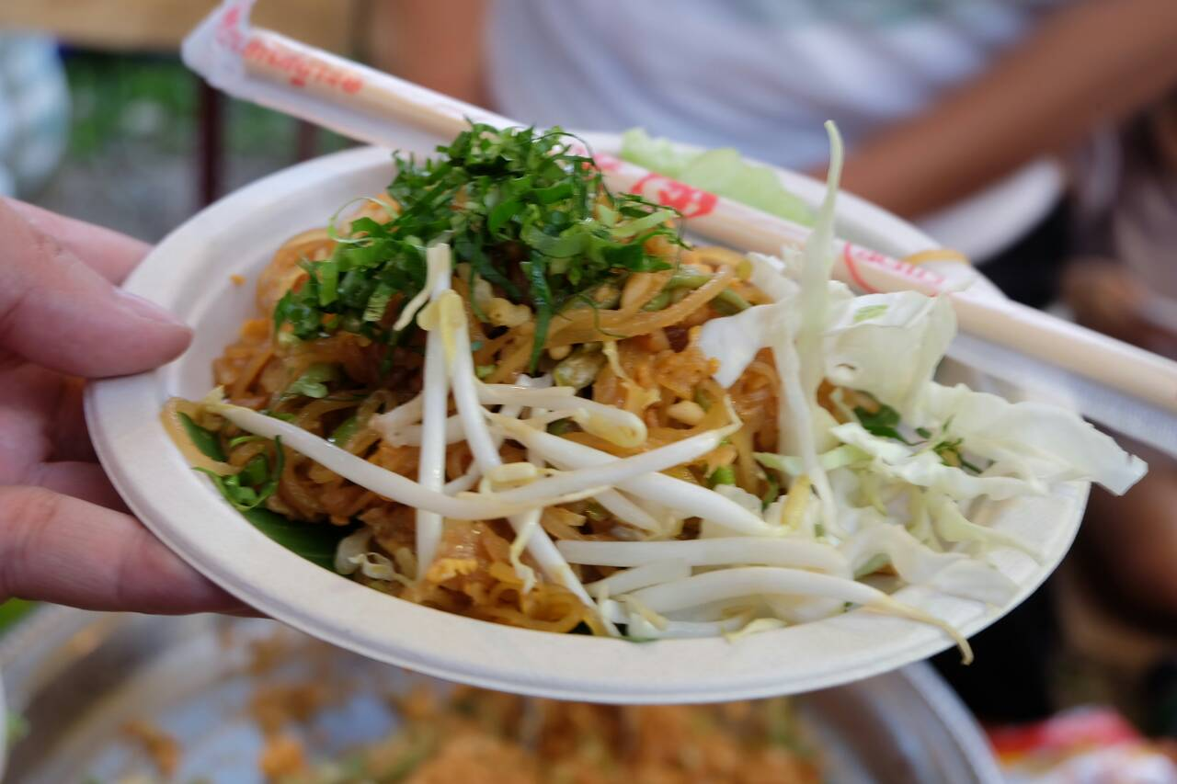
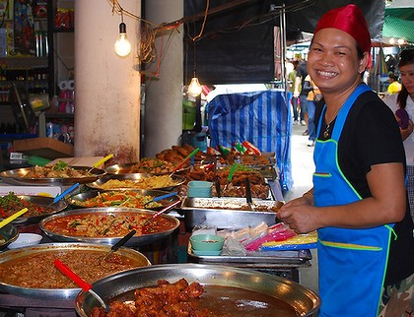
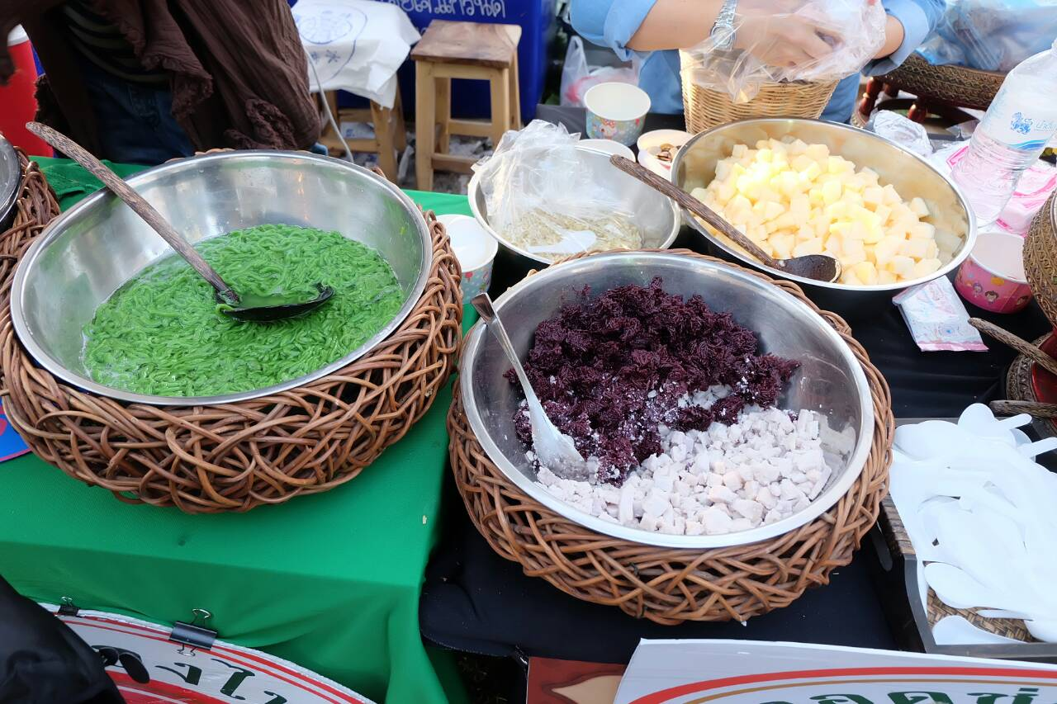

Slide 10





Slide 11


Slide 12


Kasetsart University
Bangkok, Thailand
http://www.eco.ku.ac.th/

Slide 13
Kasetsart University
Established 1943
Largest Public Research University in Thailand
Degree Programs Bachelor Masters Ph.D.
Enrollment 70,000 students
Main Campus - Bang Khen Bangkok 42,000 students

Slide 14
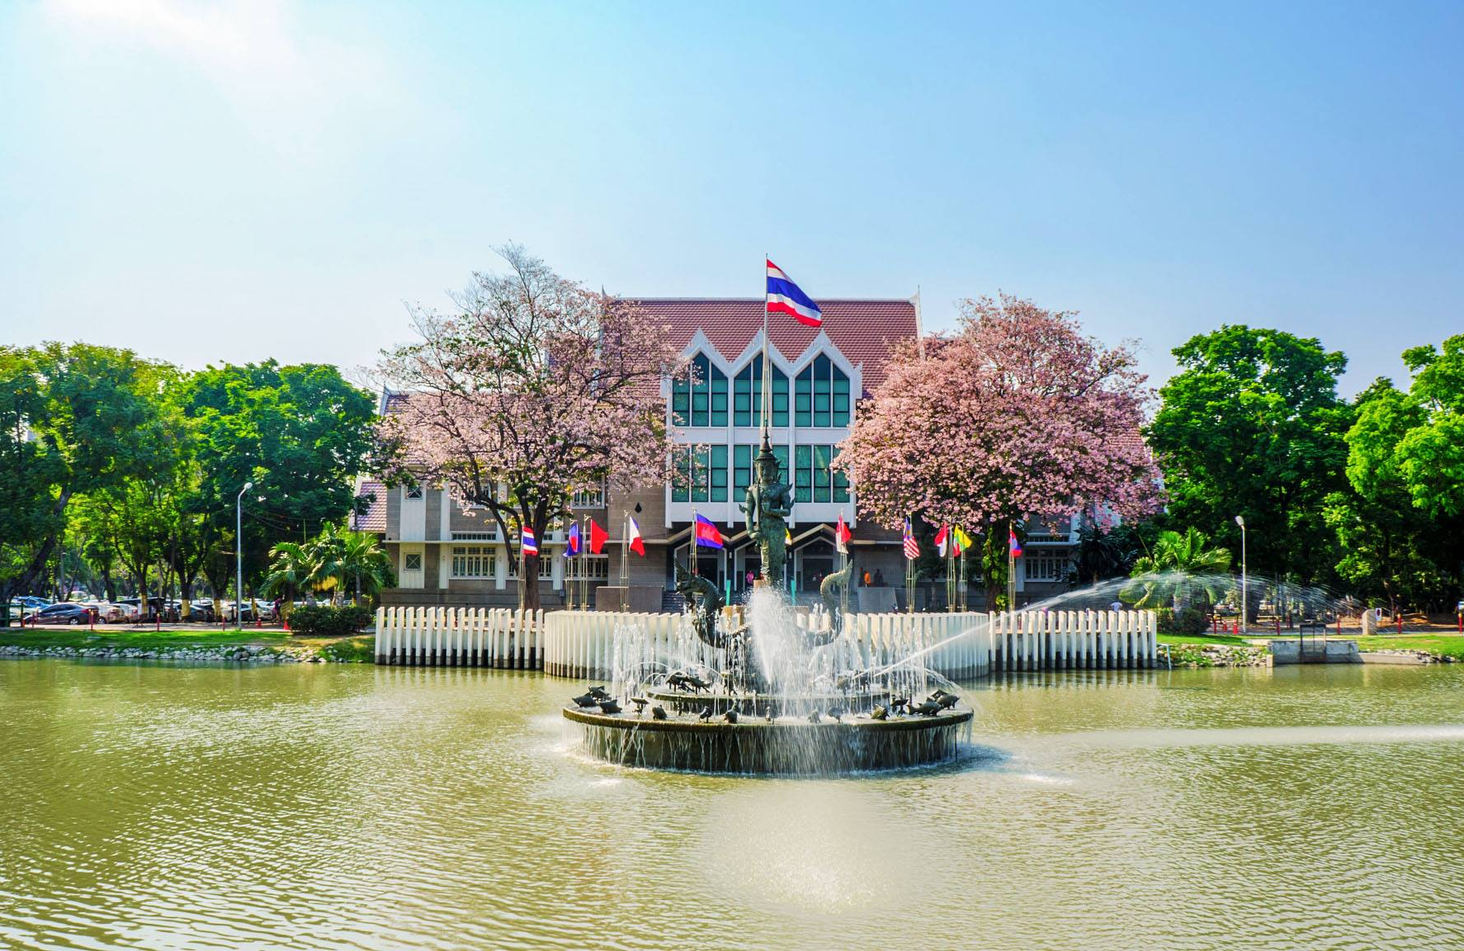
Gallery

Slide 15
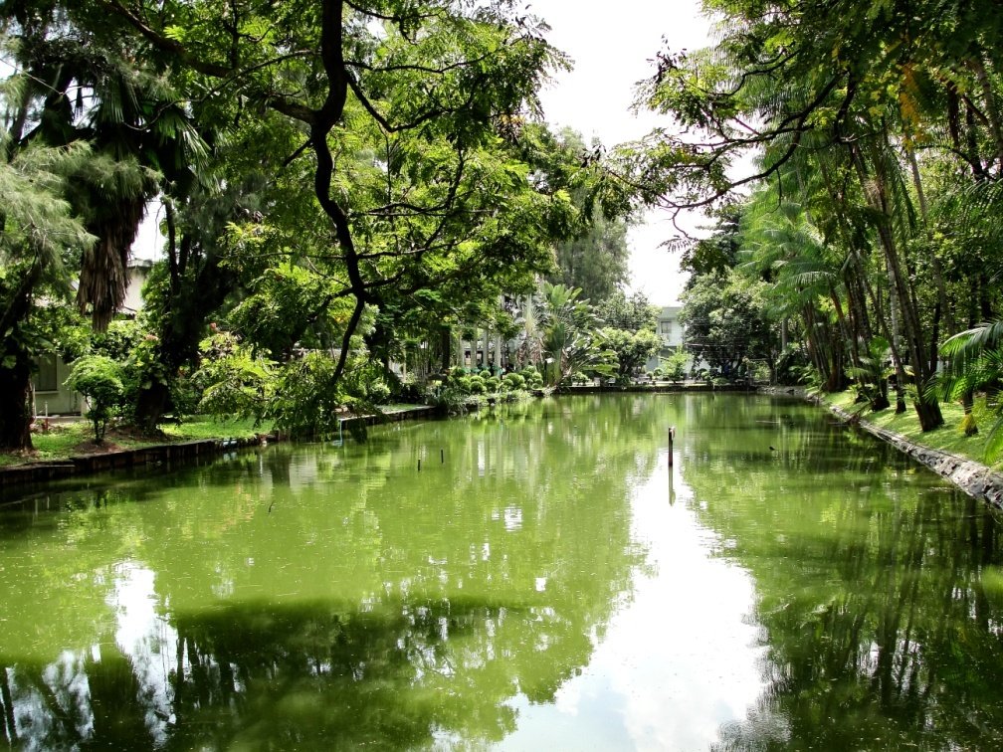
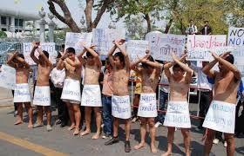
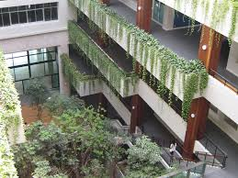
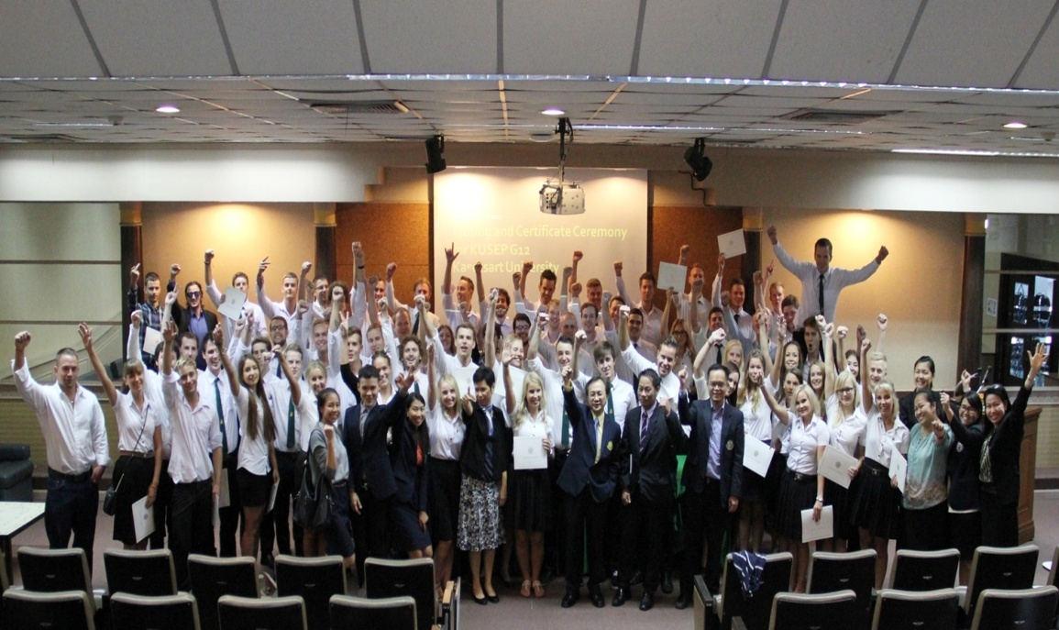

Slide 16
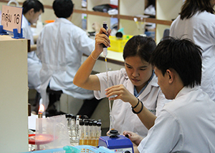
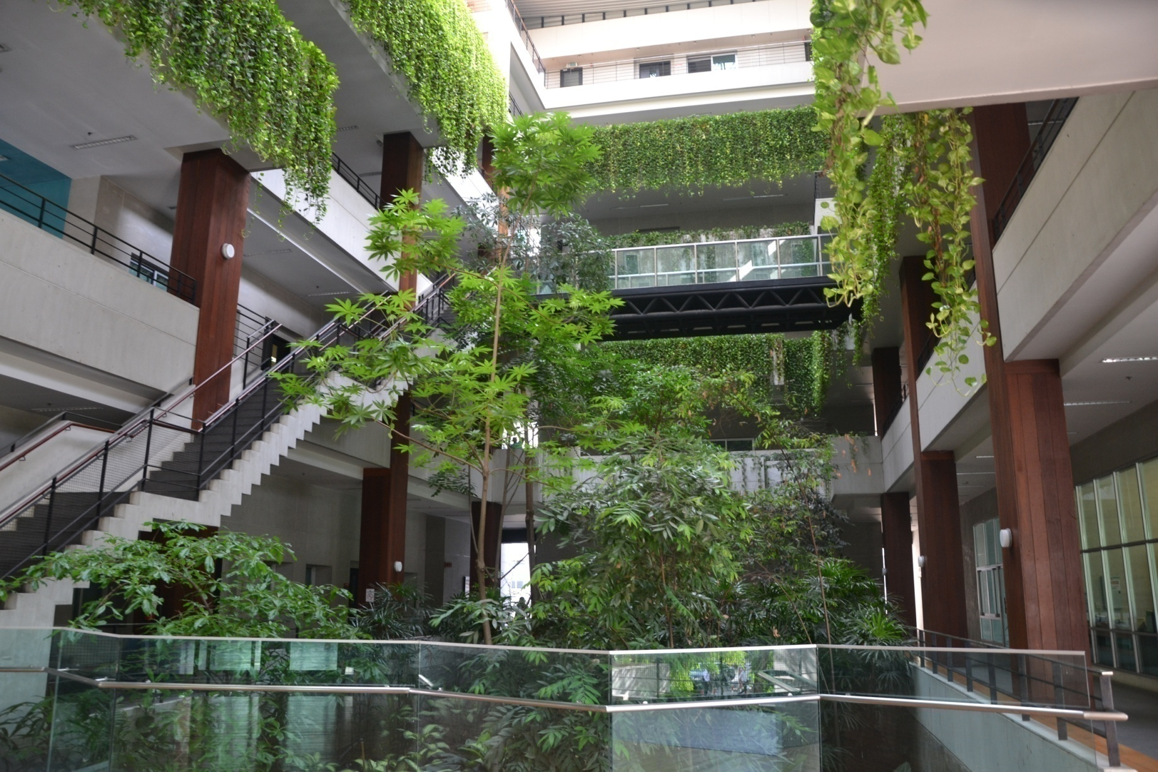

Slide 17
Kasetsart University Faculty
Agriculture Agro-Industry
Architecture Business Administration
College of Environment Economics
Education Engineering
Fisheries Forestry
Humanities Science
Social Science Veterinary Medicine
Veterinary Technology Graduate School

Slide 18
QS World University Ranking 2020 Overall +801
Region Ranking: Asia University Ranking 149
Subject Specialties:
Agriculture & Forestry 58
Biological Sciences 504
Business 477 Chemical Engineering 391
Chemistry 445 Computer Science 647
Economics 585 Electrical Engineering 527
Education 471 Environmental Sciences 295
Languages 558 Mech. Aeronautical & 457
Manufacturing Engineering

Slide 19

Faculty of Economics
Kasetsart University
Bangkok Thailand
http://www.eco.ku.ac.th/

Slide 20
FACULTY OF ECONOMICS
International Undergraduate Degree Programs
EEBA - Bachelor of Arts in Entrepreneurial Economics
Founded 2008 / enrollment 400 Students
BEcon - Bachelor of Economics (English)
Founded 2014 / enrollment 250 Students

Slide 21
Faculty of Economics – Classroom Building 5

Slide 22
Program highlights
EEBA & BEcon Degree PROGRAMS
All classes in the international degree programs are taught in English.
Emphasize on applied research
Faculty – Ph.D. from highly regarded universities (90% of the faculty who teach have completed graduate studies in English language programs abroad)
New and modern teaching facilities

Slide 23
Master’s Degree Programs
Graduate English International Program
M.S. Agricultural and Resource Economics http://agri.eco.ku.ac.th/inter/www/ms_agreco.html
M.Econ. Economics http://www.grad.eco.ku.ac.th/MECONs.html
Ph.D. Agricultural and Resource Economics
http://agri.eco.ku.ac.th/inter/www/ph_d_agreco.html

Slide 24
EEBA Major Programs
EEBA - AREAS OF FOCUS / MAJORS
Economics of Finance for Entrepreneurs
Economics of Logistics
Economics of Tourism & Hospitality
Economics of Agricultural Business & Food

Slide 25
Student Exchange Program
BEcon - BACHELOR OF ECONOMICS (ENGLISH)
Explores the theories, principles, and applications of economics on society
Areas of Focus: Economic Development & Planning, Labor, Transportation, International Trade & Finance, Fiscal & Monetary Policies, Industrial Organization, Natural Resources & Environment, Quantitative Economics & Business Economics

Slide 26
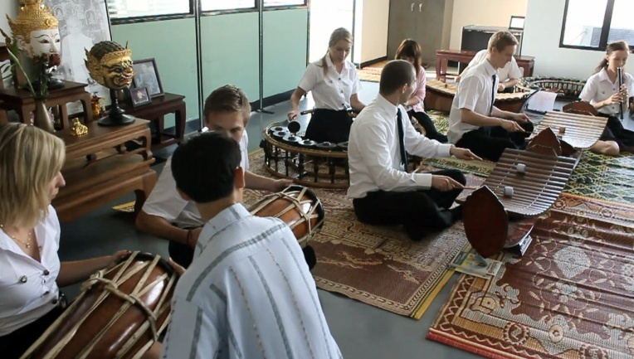

Foreign Students at Faculty of Economics Center for International Affairs – ECIA

Slide 27
Economics Hosts Foreign Students
Economics hosts 30-50 foreign students each semester
Visiting students attend regular classes for 1 or 2 semesters
Thai students interact with foreign visitors
Thai students can volunteer to serve as a ‘Buddy’

Slide 28
Exchange Eligibility
If not a native English speaker, proof of English proficiency 5.5 IELTS or equivalent is required [6.0 recommended for upper-level classes]; substantial university-level course work completed in English or other assessment provided by Home University in the Nomination Letter.
Some Faculty and Graduate level programs may have more rigorous requirements.

Slide 29
International Student Assistance
ACADEMIC Information and General ASSISTANCE at ECONOMICS
Faculty of Economics Center for International Affairs (ECIA)
Ms. Wanida Kammani, Foreign Relations Officer E: fecowdka@ku.ac.th // ecia@ku.th
HOUSING, ACTIVITIES, ORIENTATION, VISA, etc. International Studies Center (ISC)
E: ku.oip@ku.ac.th
https://sites.google.com/ku.th/isc/home

Slide 30
Application Online
APPLICATION INFORMATION Online
https://iad.intaff.ku.ac.th/wordpress/?page_id=8476
Semester 1: Mid-March
Semester 2: Mid-October
Questions: Contact International Affairs Division
E: iad@ku.th

Slide 31

Academic Calendar
First semester August – December
Second semester January – May

Slide 32
Orientation and First Day of Class
First Semester First week of August
Second Semester Second week of January

Slide 33
Final Exams / End of Semester
First Semester
Mid-December (usually before Dec 25)
Second Semester
Mid-May (usually before May 25)

Slide 34
Which courses are open to Exchange Students?
All BEcon and EEBA degree courses are taught in English [est. 35 classes/semester]
All classes are open to Exchange Students (and with permission, some classes offered by other KU Faculty)
Advisor can assist with class selection
– to ensure the Exchange Student has the proper academic background to successfully manage the class content

Slide 35
Optional courses open to Exchange Students
Enrichment - Thai language - Optional
Popular Off Campus Experiences
Thai cooking
Muay Thai exercise and training

Slide 36
Transferrable Credits
Course Load
Generally 1 credit KU = 2 credits ETCS
Min. 9 credits Max. 21 credits Undergraduate
Min. 9 credits Max. 15 credits
Graduate

Slide 37
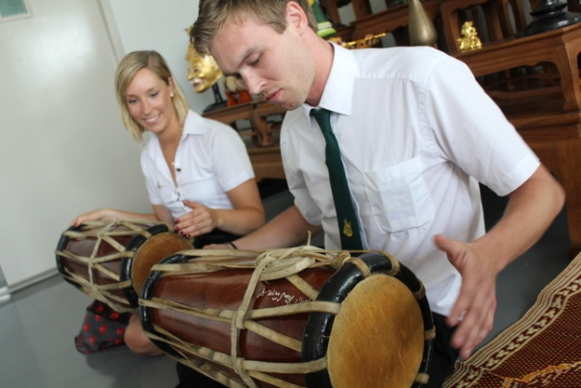
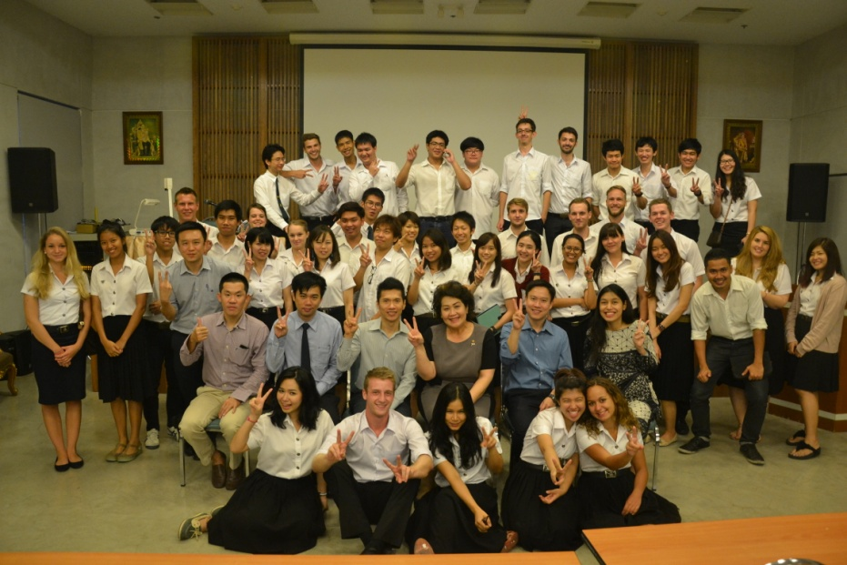
Support for Visiting Foreign Students
Buddy Program - pairs Thai and visiting students
Thai language studies
Participate in cultural activities
Tours of regional historic Thai sites

Slide 38
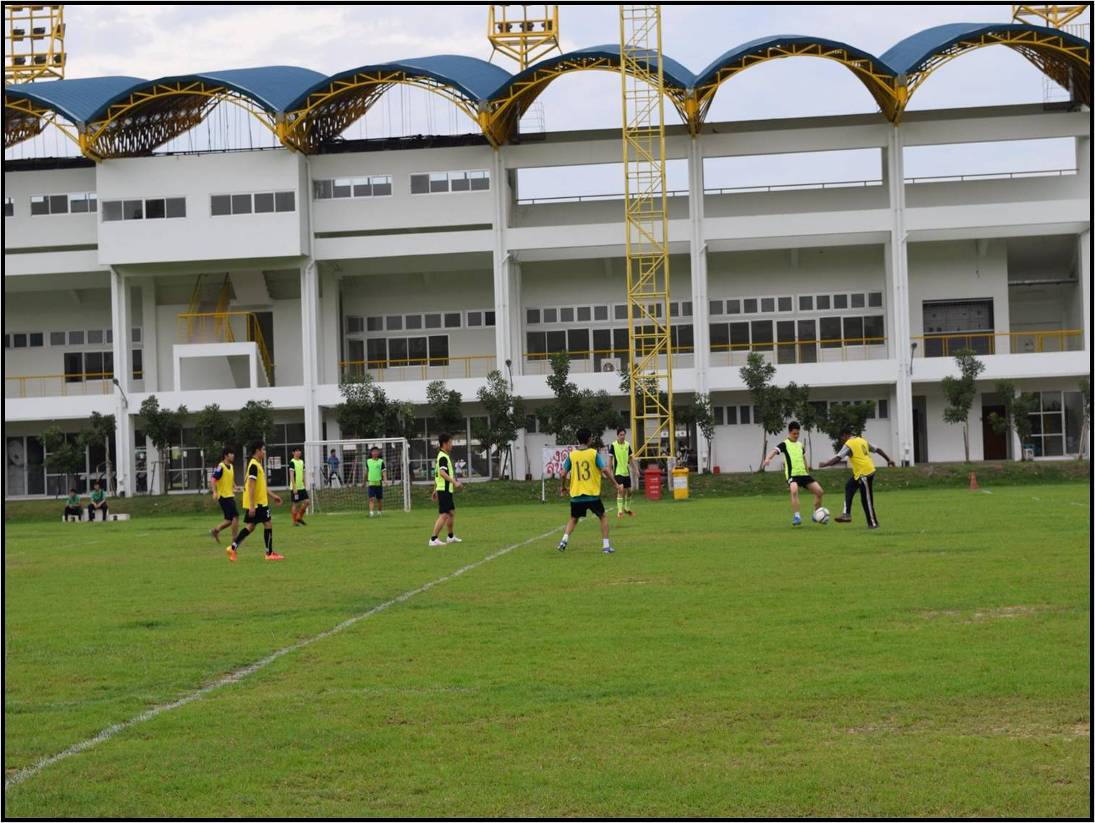

Slide 39
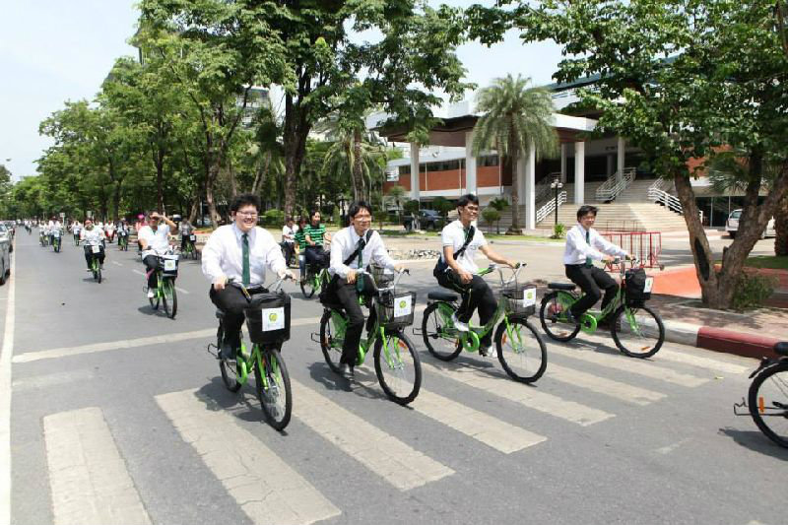
Gallery

Slide 40
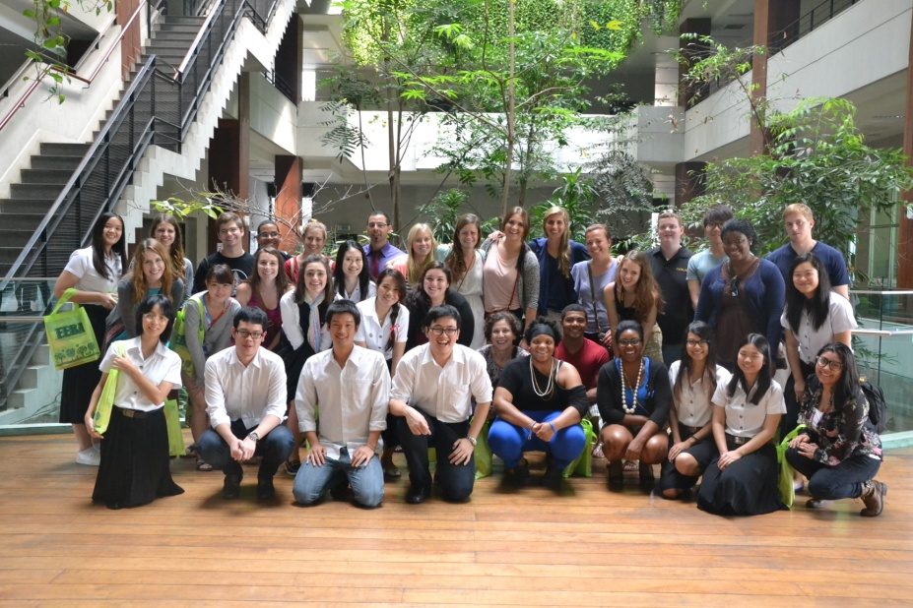
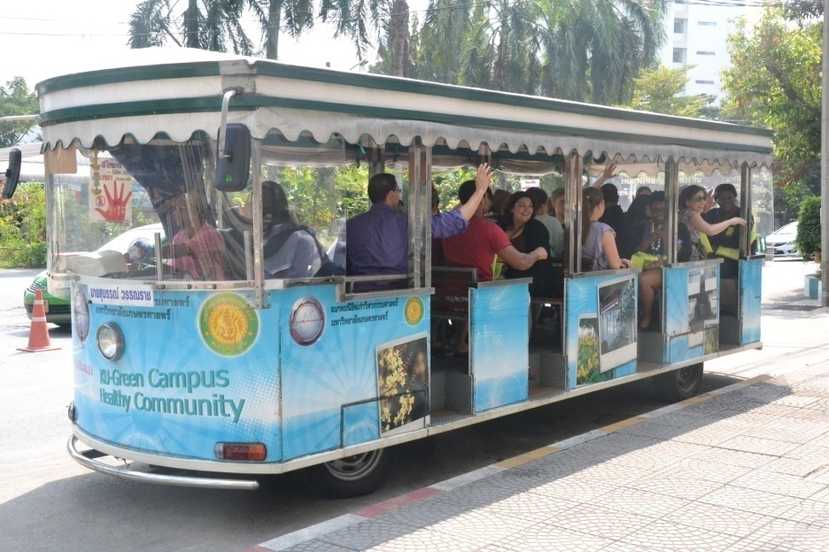
Gallery
Foreign Students visiting the Faculty of Economics

Slide 41

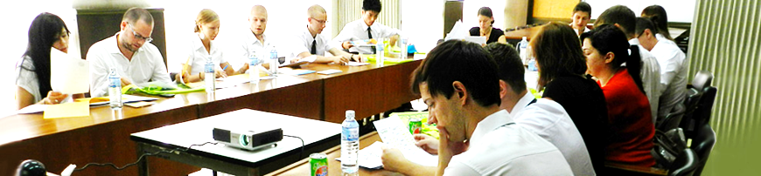
International Studies Center
To encourage and promote
international education at
Kasetsart University

Slide 42
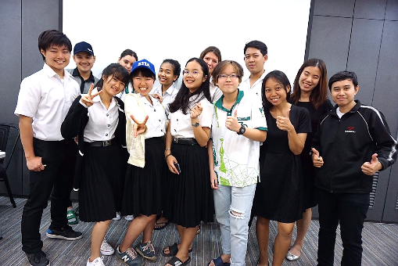

ISC Services for International Students
Application Assistance
Orientation
Class Registration
Visa Assistance
Student Scholarships
Student Accounts
Accommodations
Health Insurance
Cultural Activities

Slide 43

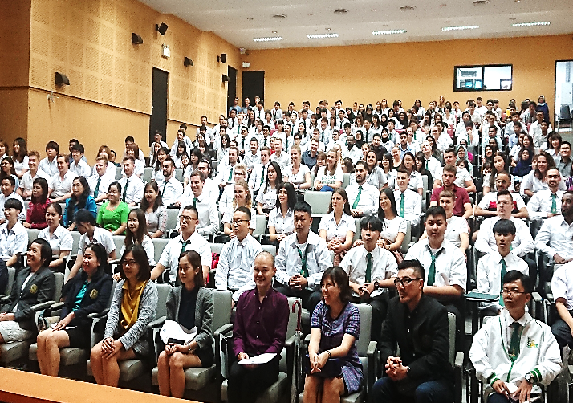
Number of International Students Semester 1 of 2019
123
Degree Program
Total International Students
375
252
Exchange Program

Slide 44
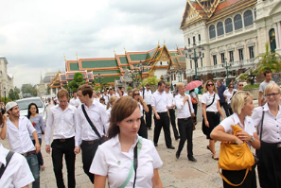
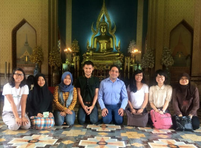
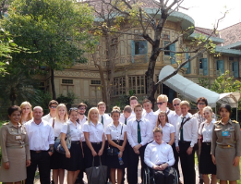
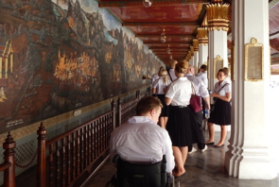
Bangkok / Cultural Trips
1-2 Trips per month
History, Art, Culture
Museums, Temples, National Parks

Slide 45
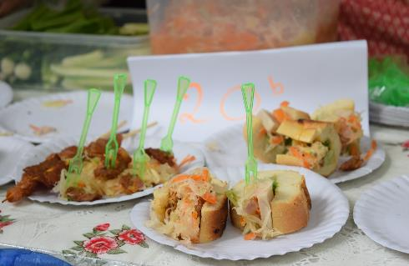
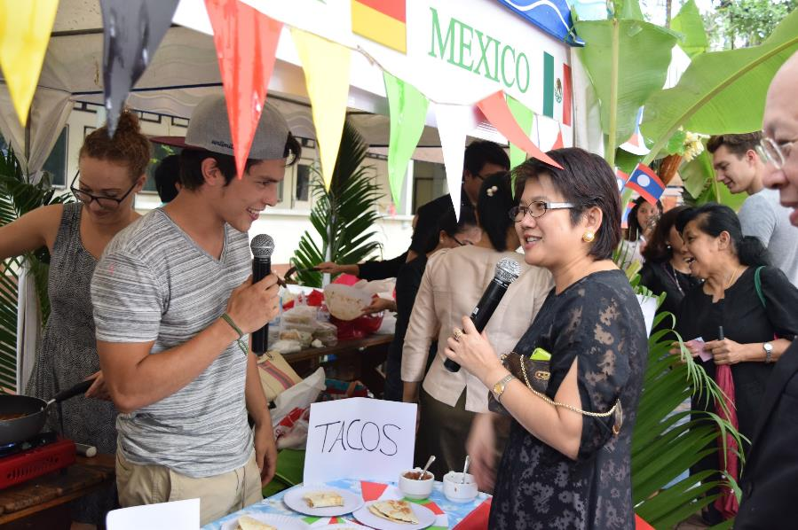
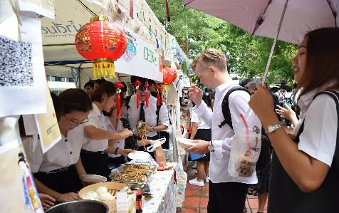
International Food Fair

Slide 46
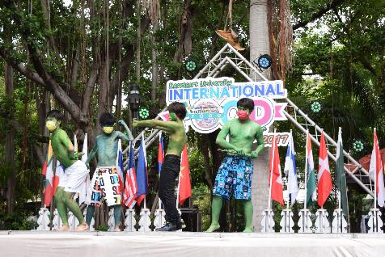
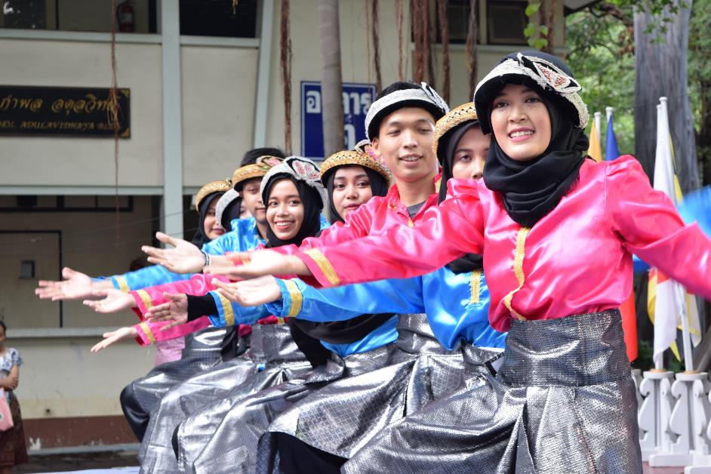
International Food Fair

Slide 47
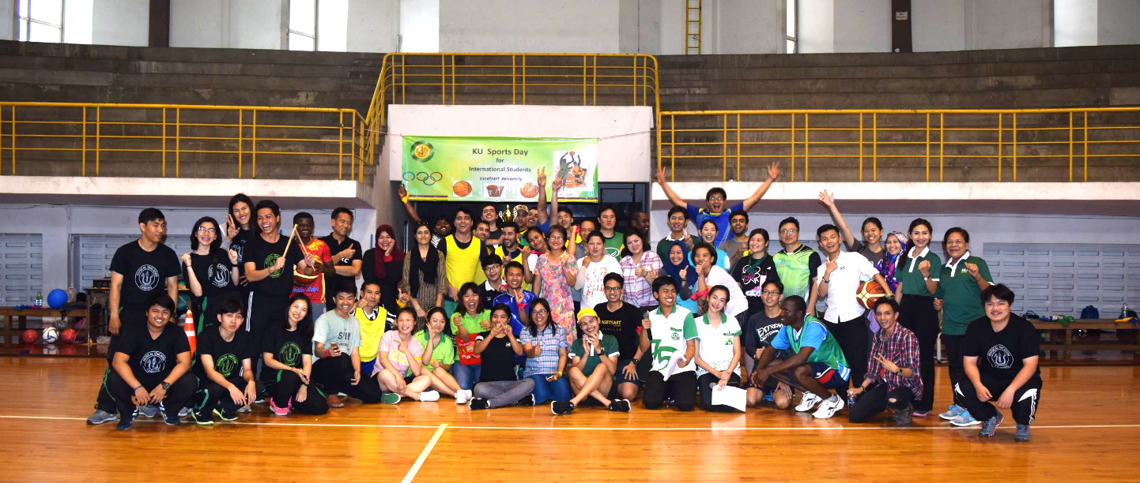
International Students Sports Day

Slide 48
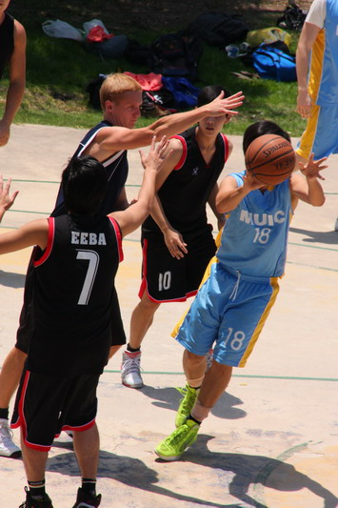
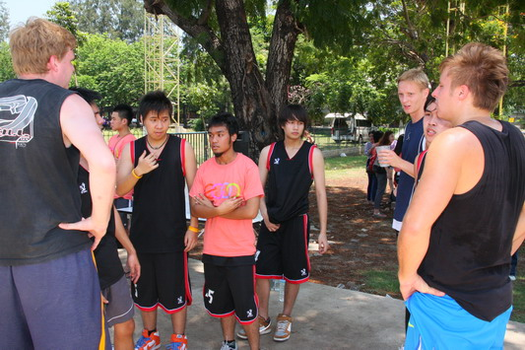

Slide 49
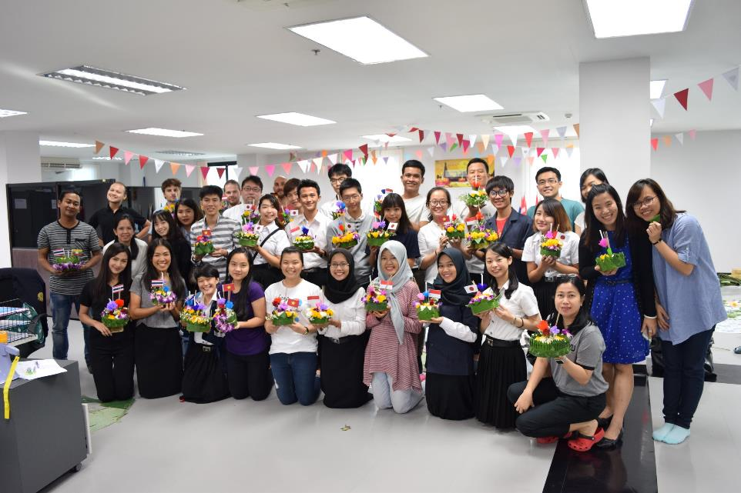

Loi Krathong Festival

Slide 50
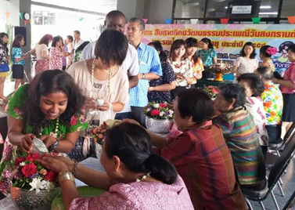
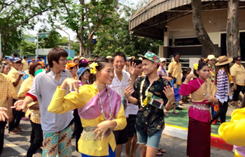
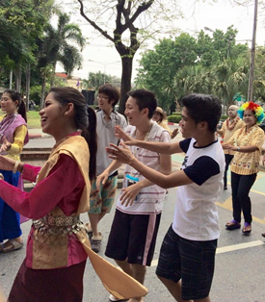
Songkran Festival (Thai New Year)

Slide 51
COSTS and HOUSING
Housing is available on campus or in nearby private apartments (15-20 minute walk)
Cost: 7,000 to 15,000 THB per month
(300 to 500 Euro per month)
International dorm or nearby private rental
Estimate COST of LIVING 800-1000 Euro / month*
*less with shared housing

Slide 52
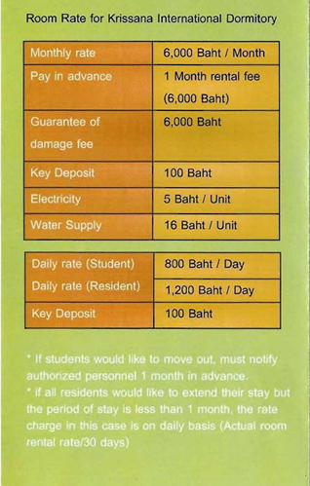


Accommodation On-campus
Krissana International Dormitory (Short or Long-Term Study)

Slide 53

Accommodations are readily available Off-campus
TPY5 Apartment (example) . . . 20 minute walk to classroom English-speaking staff, pool, fitness room

Slide 54



Housing off-campus
TPY5 Apartment (example)

Slide 55


ISC Website
To stay updated with what’s going on at the ISC:
ISC Website - https://sites.google.com/ku.th/isc/home
ISC on Facebook - www.facebook.com/isc.ku
For information contact
ku.oip@ku.ac.th

Slide 56

KU ECON Partners / Studies Abroad in

Slide 57
Partners - Study Abroad in
BANGLADESH
CHINA
DENMARK
ENGLAND
FINLAND
FRANCE
GERMANY
HONG KONG
INDIA
INDONESIA

Slide 58
Partners - Study Abroad in
JAPAN
MALAYSIA
NETHERLANDS
NEW ZEALAND
RUSSIA
SCOTLAND
SOUTH KOREA
SWEDEN
SWITZERLAND
TAIWAN
USA
UNITED ARAB EMIRATES
VIETNAM

Slide 59
International Student Assistance
ACADEMIC Information and General ASSISTANCE at ECONOMICS
Faculty of Economics Center for International Affairs (ECIA)
Ms. Wanida Kammani, Foreign Relations Officer E: fecowdka@ku.ac.th // ecia@ku.th
HOUSING, ACTIVITIES, ORIENTATION, VISA, etc. International Studies Center (ISC)
E: ku.oip@ku.ac.th
https://sites.google.com/ku.th/isc/home

Slide 60
Please join us!
Faculty of Economics
Welcomes Exchange Students
Kasetsart university International program
Phone 02 579 2800
Email eeba@ku.ac.th
Website www.eeba.eco.ku.ac.th

