Slide 1

Study Abroad
10 november 2022 International Office PTRS

Slide 2

Possibilities for study or internship abroad
Short Stay
Study Trips
Module “Edges of Europe” (not sure if this will take place in 2022-23 or 2023-24)
Summer schools
Buitenlandminor: semester abroad
Internship
Study

Slide 3
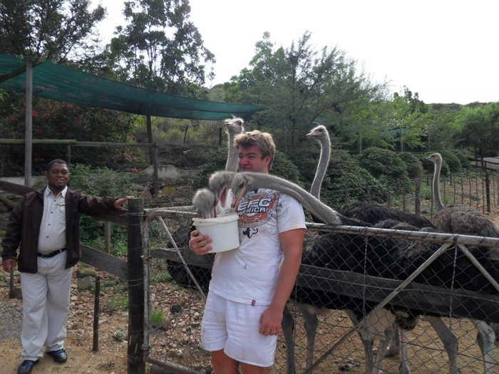
Why study abroad?
Transferable skills
Different culture
Learn a language (better)
Study with a professor you admire
Study program
Make new friends
Get to know a country or city

Slide 4
Semester abroad – planning
BA students
Admitted to year 2, minimum of 60 EC before departure
Mobility windows:
PPS - Filosofie - Theologie – Religie, Politiek en Samenleving: 1st semester B3 (PPS poss. 2nd semester B2)
Islam, Politiek en Samenleving: 3rd period B2 (minor in Caïro)
MA Students
Research master: 1st semester 2nd year
Other MA’s : no mobility window, possibilities available on individual basis
Study delay?
Not necessarily → 30 EC abroad (less possible)
Study advisor

Slide 5
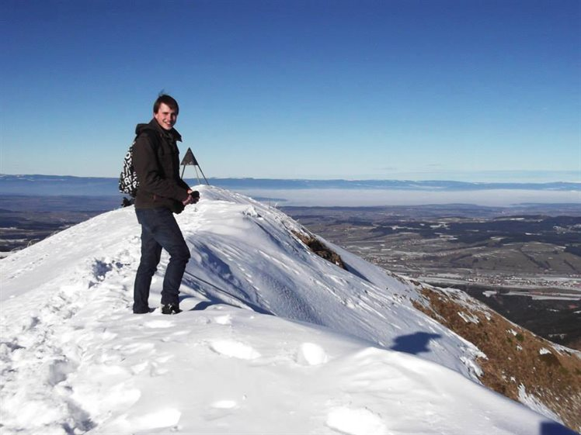
Semester abroad– destinations
Partner universities: tuition fee – ECTS – study programme
Limited places per destination
PTRS partner universities: Website International Office PTRS
Radboud University partner universities - open to all Radboud Students: Website Radboud University International Office

Slide 6
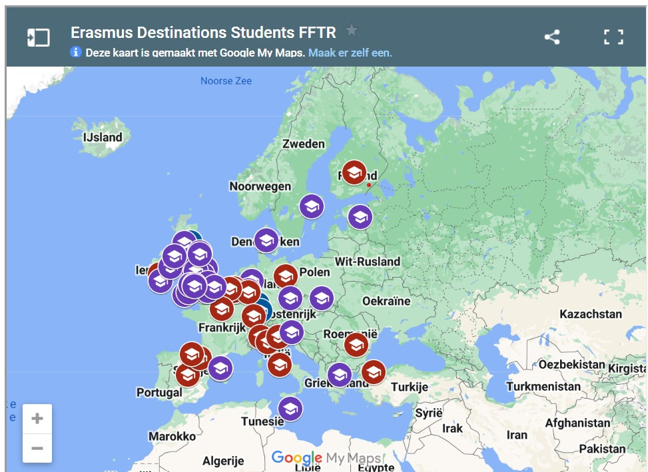
Erasmus+ destinations (Europe, inlcuding Türkiye and UK)

Slide 7
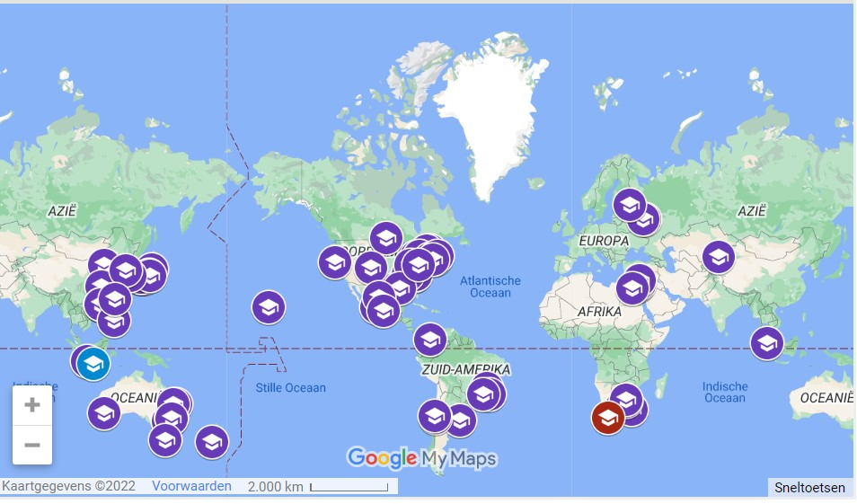
Non-Erasmus Destinations

Slide 8
Semester Abroad – making the right choice
Check
Course offer
Prerequisites: GPA, language proficiency, minimum EC
Semester start-end
Finances
Housing
Campus university
Small of big university
Country, city
Ask teachers, fellow students, study advisor
Meet the International Office PTRS

Slide 9
Semester abroad – finances - costs
Radboud University – tuition fee (re-enroll at Radboud University)
Service costs may apply at partner university (USA, South Africa, Australia)
Housing
Living (necessary and fun)
Travel
Vaccinations
Visa

Slide 10
Semester abroad – finances - income
Scholarships
Erasmus+
EER countries, including Türkiye: 8-12 euro per day
Erasmus+ Inclusion top-up
EER countries, including Türkiye and UK, for students with special needs and/or coming from a low income family (8,33 euro per day)
Erasmus+ Green Travel top-up:
all EER destinations + Türkiye (one off bous of 50,- euro + 4 extra grant days)
Holland Scholarship, Individuel Travel Grant, Erasmus UK
non EER countries, +/- 1200,- per stay
Other
DUO
OV (€98 pm)
Sublet room via Radboud IO (350,- bonus!)

Slide 11

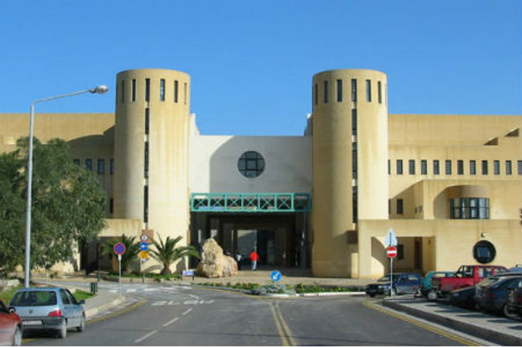

Students that have been on exchange: Janna – University of Helsinki, Simone – University of Malta, Emma – University of Bonn

Slide 12
Study abroad – application in Osiris - 2023-24
Apply through Osiris “study abroad"
Top 2 (mandatory) – top 4 partner universities
Motivation letter
Check language requirements
Check GPA requirements (not at all partner universities)
Check available exchange courses (for MA students: if partner university doesn’t offer MA courses, are you allowed to take BA courses?)
Familiarize yourself with the process of finding accommodation
What is the approximate budget you need

Slide 13
Study abroad – Deadlines for application in Osiris 2023-24
Deadlines for study:
Outside EER – 31 January 2023, 23:59hrs.
In EER (including UK and Türkiye) – 28 February 2023 , 23:59hrs.
Deadlines also apply for study abroad in second semester.

Slide 14
Information and questions
Information
www.ru.nl/ftr/studereninhetbuitenland
International Office PTRS
Individual appointment: internationaloffice@ftr.ru.nl (online or on campus)
Open door E15.27 Tuesdays and Thursdays 14:00-15:00 hrs. or whenever we are in the office
Facebook International Office FFTR
Instagram Faculteit_ftr
Questions?

